Slide 1
ICS 432 – 01 Distributed and Cloud Computing Fall 2021
Instructor: Thanaa Ghanem
thanaa.ghanem@metrostate.edu
Lectures 8
October 16, 2021

Slide 2
Introduction
So far, we learned about the basic cloud services (including compute, storage, networking, and storage).
In this part of the course, we are going talk about theortical concepts behind cloud computing.
The design and use of computers encountered a lot of advances over the previous decades, however, still the same basic concepts are used
Cloud computing is a branch of Distributed Computing.
Cloud computing is implemented using several technologies that have been adopted in the various fields of computing.

Slide 3
Topics
Cloud-Enabling Technology
Broadband network & the internet
Data Center Technology
Virtualization
Web Technology
Multitenant software architecture
Service Technology
Virtualization
Computer System Operation
Virtualization concepts

Slide 4
Reading
Cloud-enabling Technology
CCC Chapter 5
Provided by the library through the following link. (password: cloud)
Virtualization
I assembled a document from:
MCC chapter 3,
OSC chapter 1, and
OSC chapter 16.

Slide 5
Cloud-Enabling Technology
The following is a set of primary technology components that collectively enable key features and characteristics associated with contemporary cloud computing
Broadband network and Internet Architecture
Web Technology
Multitenant Technology
Service technology -- more details in an upcoming lecture
Data Center Technology
(Modern) Virtualization Technology -- details in the second part of this lecture

Slide 6
Cloud Enabling Technologies
The following is a set of primary technology components that collectively enable key features and characteristics associated with contemporary cloud computing
Broadband network and Internet Architecture
Web Technology
Multitenant Technology
Service technology -- more details in an upcoming lecture
Data Center Technology
(Modern) Virtualization Technology -- details in the second part of this lecture

Slide 7
Cloud Enabling Technologies (1/6) Broadband networks and Internet Architecture
Clouds are inherently dependent on internetworking.
remote provisioning of IT resources
ubiquitous network access.
The potential of cloud platforms generally grows in parallel with advancements in Internet connectivity and service quality.

Slide 8
Understanding Networking
Internet Service Providers (ISP)
Connectionless Packet Switching
Router-based Interconnectivity
Technical and Business consideration

Slide 9
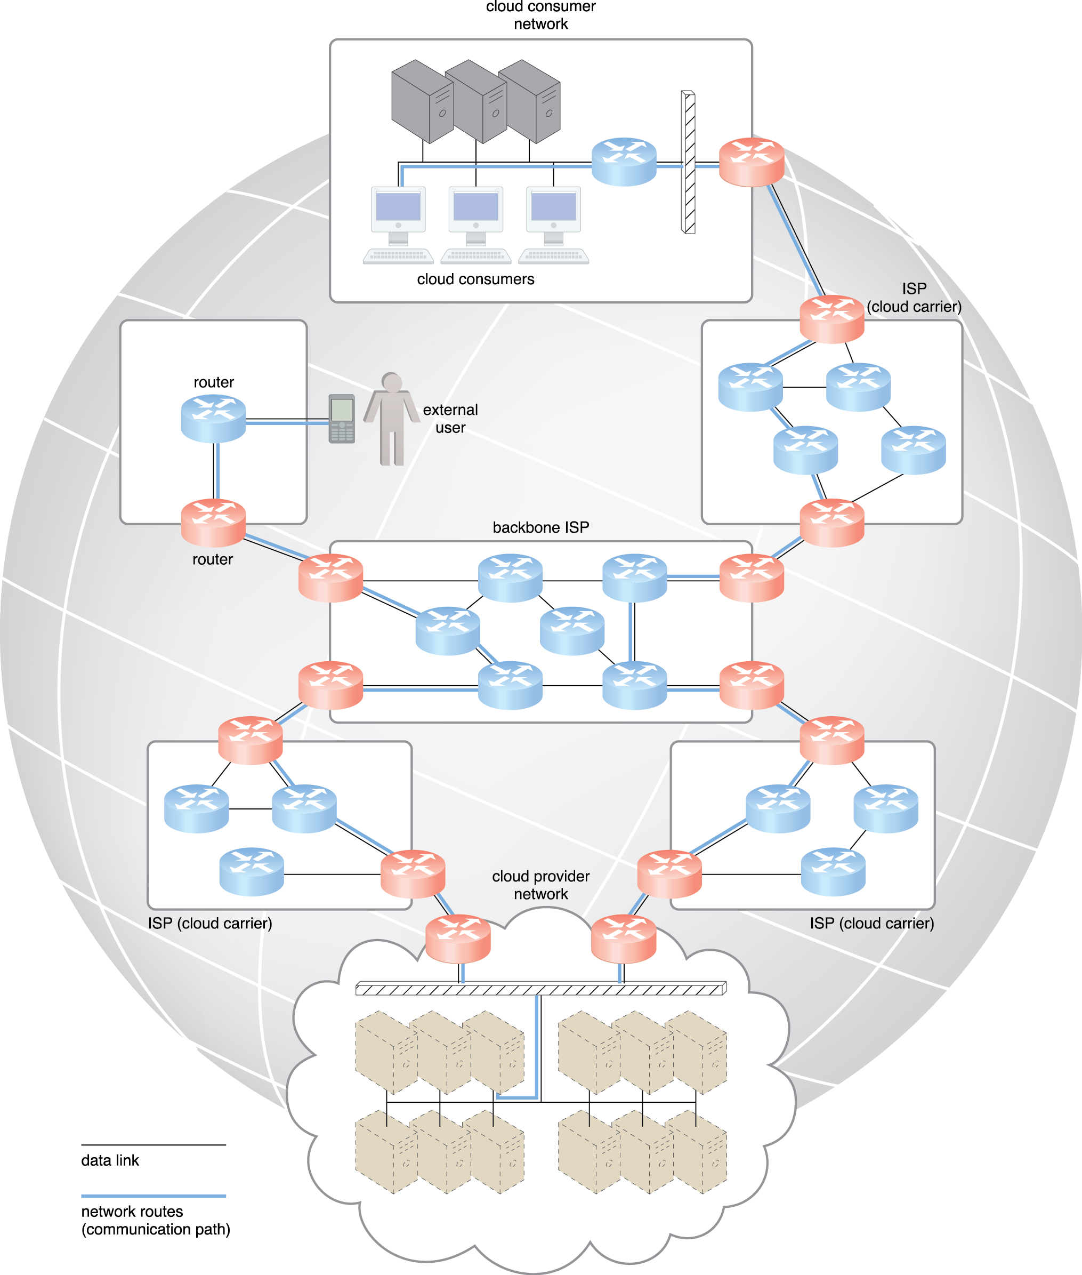
Internet Service Provider (ISP)
There is no centralized entity that comprehensively governs the internet.
Internet Corporation for Assigned Names and Numbers (ICANN) supervise and coordinate Internet communications.
An ISP network interconnects to other ISP networks and various organizations.
ISPs can freely deploy, operate and manage their networks in addition to selecting partner ISPs for interconnection.

Slide 10
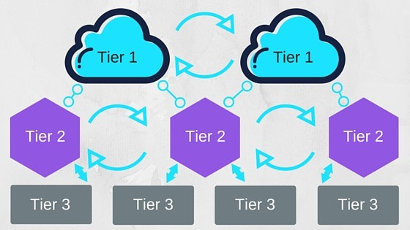
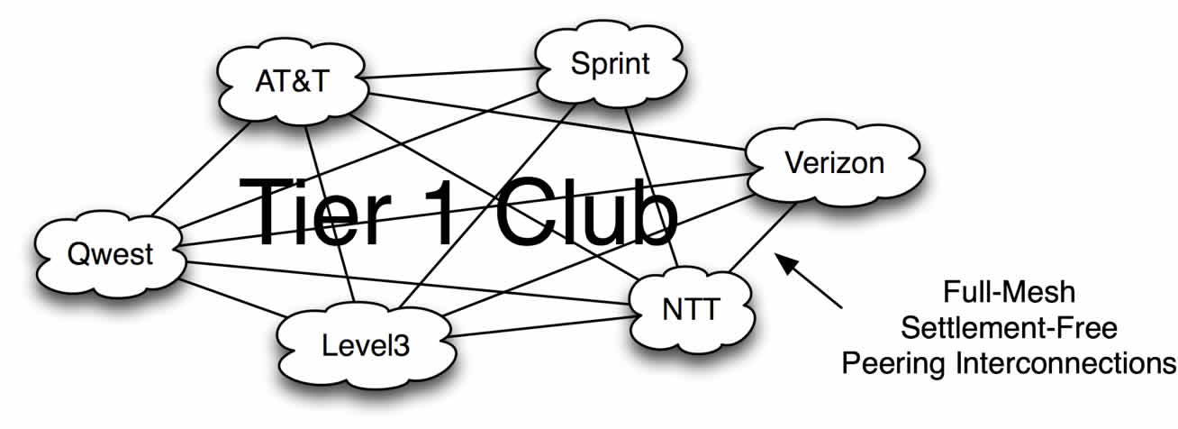
ISP 3-Tier model:
Tier 1: carriers with Tier-1 networks can reach every other network on the internet via settlement-free peering.
they own enough of the physical network lines to carry most traffic themselves, and negotiate with other Tier-1 networks to get free access to their networks, and vice versa.
Tier 2: carriers with Tier-2 networks are the most common internet service providers (ISPs).
They peer with other comparably-sized Tier-2 networks, but they’re obligated to purchase access to larger Tier-1 networks.
Tier 3: carriers in this tier are usually last mile providers, meaning they connect consumers to the internet without a network of their own, servicing only the connection leading into your home or office.

Slide 11
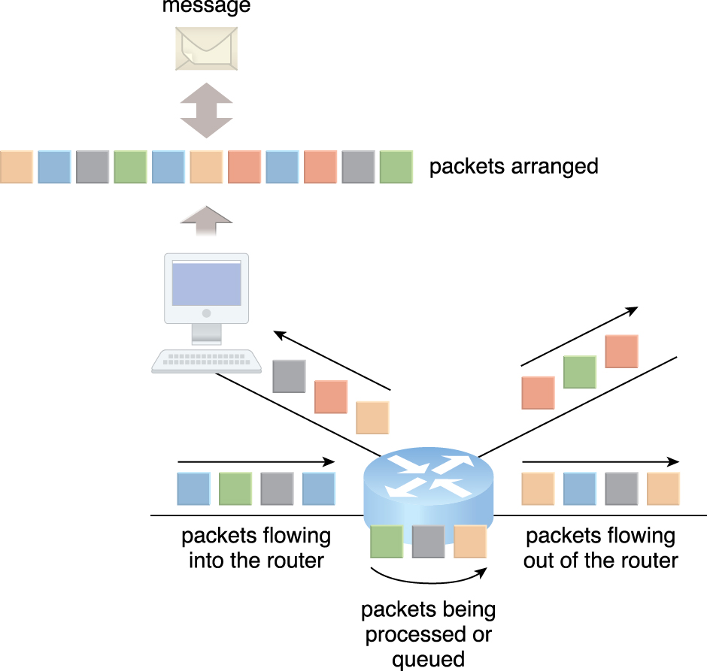
Internetworking
Two fundamental components used to construct the internetworking architecture:
Connectionless packet switching (datagram networks)
data flows are divided into packets of limited size
packets are received and processed through network switches and routers
packets are queued and forwarded from one intermediary node to the next.
Each packet carries necessary information (e.g., internet protocol, addresses)
Router-based interconnectivity.
a router is a device that is connected to multiple networks through which it forwards packets
routers process and forward packets individually
routers maintains the network topology information to locate the next node on the communication path between the source and destination nodes.

Slide 12
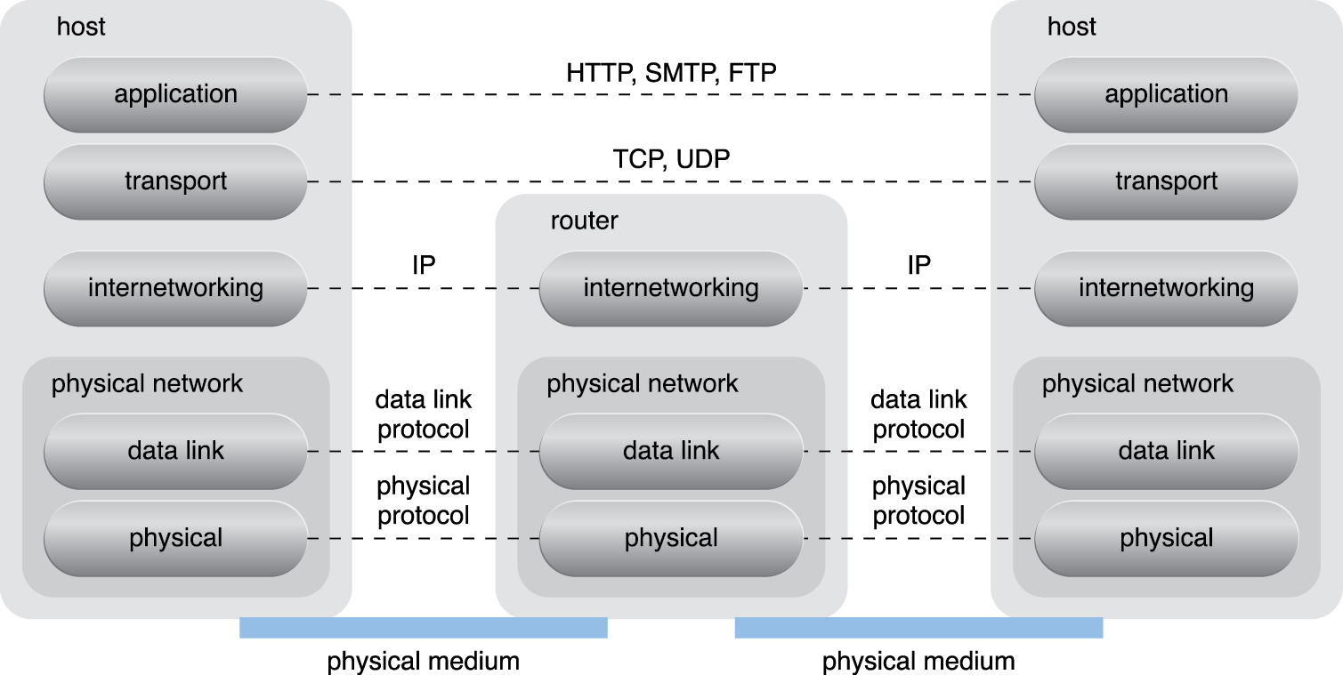
Internet Protocol Stack

Slide 13
Internetworking Protocols
Physical layer
data link layer: controls data transfer between neighboring nodes
physical layer: transmits data bits through both wired and wireless media.
Transport layer protocol
Examples: Transmission Control Protocol (TCP), Use Datagram Protocol (UDP)
provides standardized, end-to-end communication support the navigation of data packets across the internet.
Application layer protocol
Examples: HTTP, SMTP for email, DIP for IP telephony
use transport layer protocols to standardize and enable specific data data transferring methods over the internet.

Slide 14
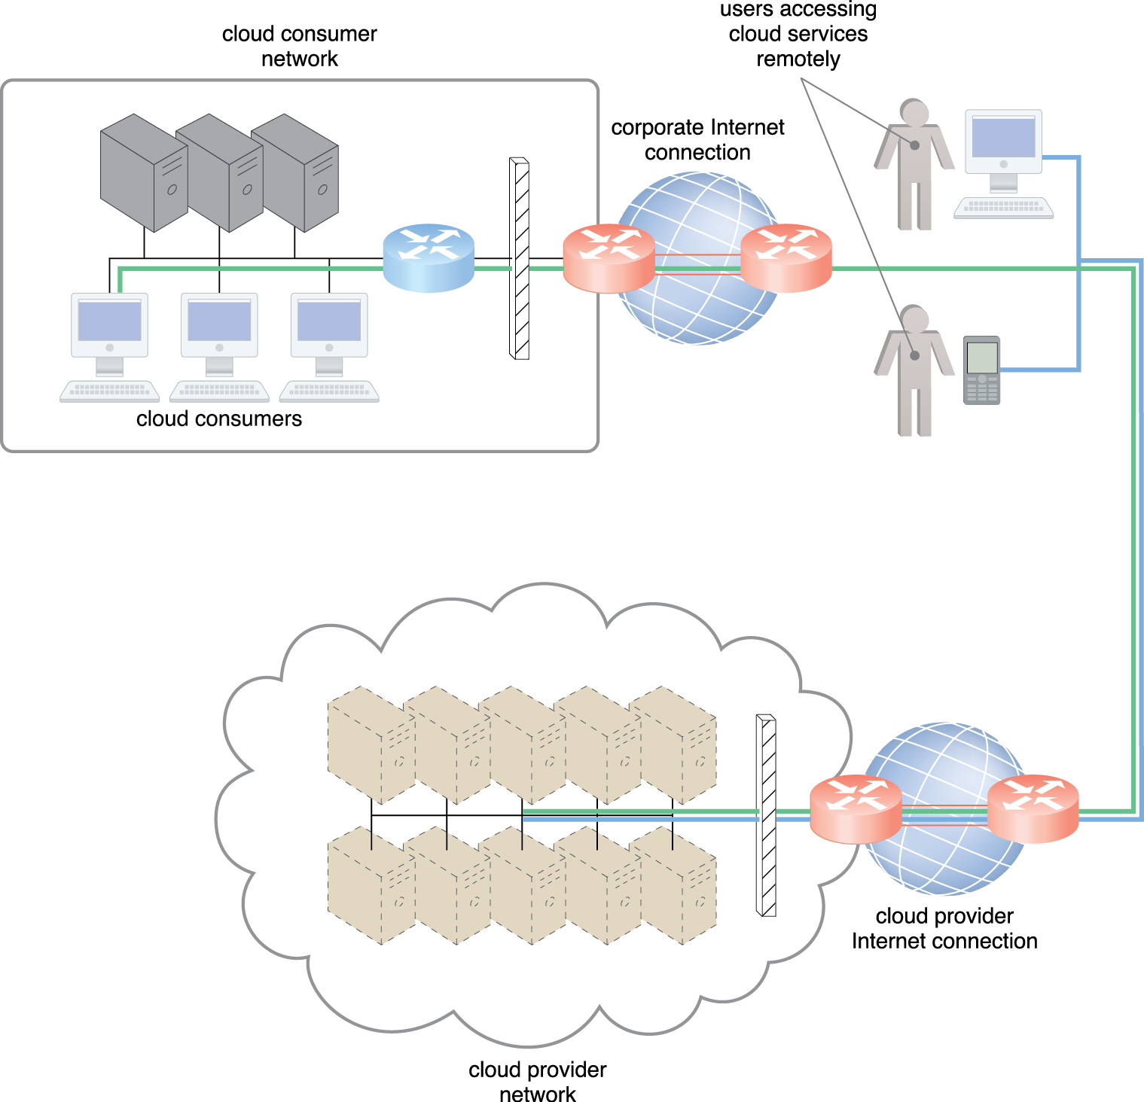
Technical and Business Considerations (1)
Connectivity Issues:
in traditional, on-premise deployments, the corporate network provides uninterrupted internet connectivity over LANs.
safeguarded using firewalls and monitoring software.
IT resources are located and managed within the organization.
cloud providers configure cloud-based IT resources to be accessible for both external and internal users through an internet connection.

Slide 15
Technical and Business Considerations (2)
Network bandwidth and latency issues
end-to-end bandwidth is determined by the transmission capacity of the shared data links that connect intermediary nodes.
ISPs need to guarantee end-to-end connectivity.
latency is the amount of time it takes a packet to travel from one data node to another
Latency is highly variable and often unpredictable.
Latency increases with every intermediary node on the data packet’s path
Networks are dependent on traffic conditions on shared nodes
Data flows that use congested network paths suffer service-level degradation in the form of bandwidth reduction, latency increase or packet loss.
IT solutions need to be assessed against business requirements that are affected by network bandwidth and latency.
bandwidth: critical for applications that require substantial amounts of data transfer
latency: critical for applications that require swift response.

Slide 16
Technical and Business Considerations (3)
Cloud carrier and cloud provider selection:
the service levels of Internet connections between cloud consumers and cloud providers are determined by their ISPs which are usually different.
Multiple ISP networks in a path
QoS management across multiple ISPs is difficult to achieve in practice.
Cloud adoption can be easier for applications with more relaxed latency and bandwidth requirements.

Slide 17
Summary
Cloud consumers and cloud providers typically use the internet to communicate which is based on a decentralized provisioning and management model and is not controlled by any centralized entities.
The main components of internetworking architecture are:
connectionless packets
router-based connectivity that use network routers and switches.
Network bandwidth and latency are characteristics that influence QoS which is heavily impacted by network congestion.

Slide 18
Cloud Enabling Technologies
The following is a set of primary technology components that collectively enable key features and characteristics associated with contemporary cloud computing
Broadband network and Internet Architecture
Web Technology
Multitenant Technology
Service technology -- more details in an upcoming lecture
Data Center Technology
(Modern) Virtualization Technology -- details in the second part of this lecture

Slide 19
Cloud-Enabling Technology (2/6) Web Technology
Web is both the implementation medium and the management interface for cloud services.
web browser universality
ease of web-based service development
Web technologies that are related to cloud services
Basic Web technologies
web browsers, web servers, and standardized protocols (URL, HTTP, and HTML)
Web applications

Slide 20
Basic Web Technology
Web = browser client + Web Server
Technologies to improve web application characteristics:
caching services, gateways, and load balancers
these technologies reside in a layered architecture that is positioned between the client and the server
Web resources are represented using hypermedia (e.g., graphics, audio, video, or plain text)
some types of hypermedia resources cannot be rendered without additional software or browser plug-ins.

Slide 21
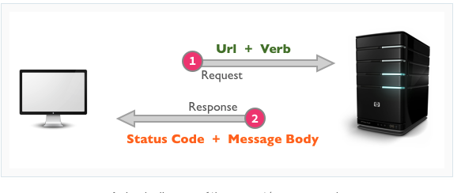
Web Standards
Uniform Resource Locator (URL)
a standard syntax used for creating identifiers that point to web-based resources
structures using a logical network location
Hypertext Transfer Protocol (HTTP)
primary communication protocol
used to exchange content and data through the web
Markup languages (HTML and XML)
a lightweight means of expression web-centric data and metadata
HTML → used for web pages
XML → used for metadata

Slide 22
How the web works?
a web browser request to execute an action (e.g., read, write, update, or delete) on a web resource.
identify and locate the resource using URL
the request is sent using HTTP to the resource host
the web server locates the web resource and performs the requested operation
a response (represented in HTML and/or XML) is sent back to the client

Slide 23
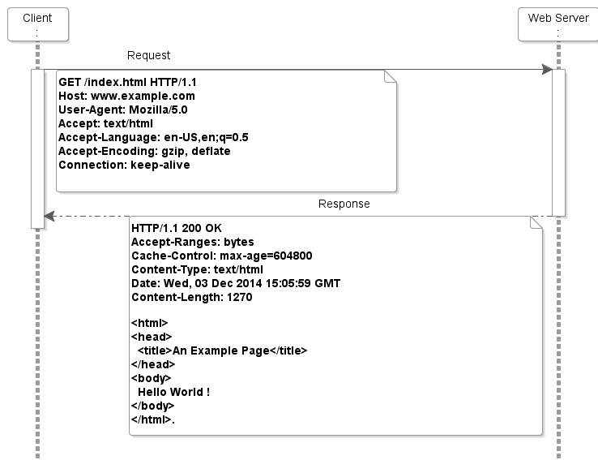
Example HTTP session

Slide 24
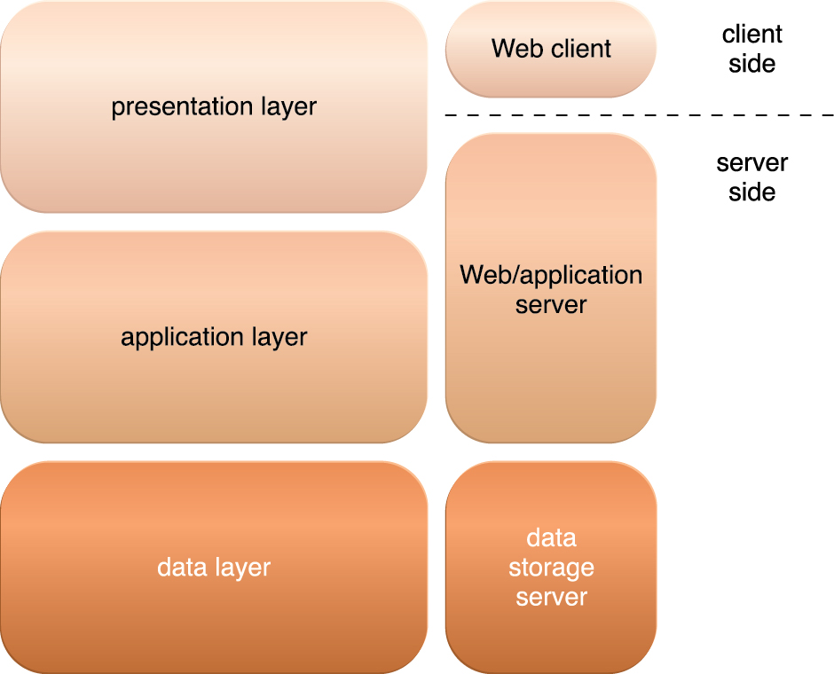
Web Applications
A web application is a distributed application that uses web-based technologies and relies on Web browsers for the presentation of the user interface.
Architectural abstraction of web applications:
Three-tiers model:
Presentation layer: user interface
Application layer: implementation of application logic
application server executes application logic and interacts with databases
Data layer: persistent data stores (e.g., databases)
PaaS offering: web server + application server + storage server.
The three basic architectural tiers of Web applications.

Slide 25
Cloud-Enabling Technology
The following is a set of primary technology components that collectively enable key features and characteristics associated with contemporary cloud computing
Broadband network and Internet Architecture
Web Technology
Multitenant Technology
Service technology -- more details in an upcoming lecture
Data Center Technology
(Modern) Virtualization Technology -- details in the second part of this lecture

Slide 26
Cloud-Enabling Technology (3/6) Multitenant Technology
Multiple users (tenants) are accessing the same application logic simultaneously.
Tenants are unaware of other tenants who are using the same application.
Each tenant has its own view of the application that uses, administer and customizes as a dedicated instance of the software.
Rely on the use of virtualization technologies.
Tenants can individually customize features of the application such as:
User interface, business process, data model, and access control
Multitenant application architecture is significantly more complex than single-tenant application
Handle sharing of portals, middleware, and databases
Maintain security

Slide 27
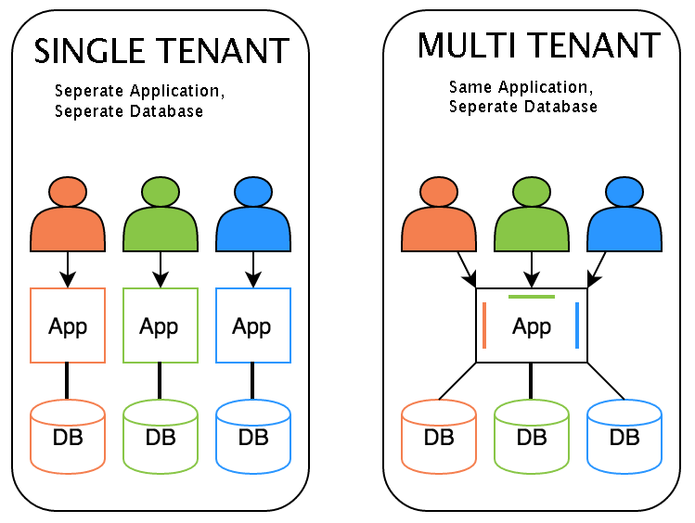
Multitenancy (continued)

Slide 28
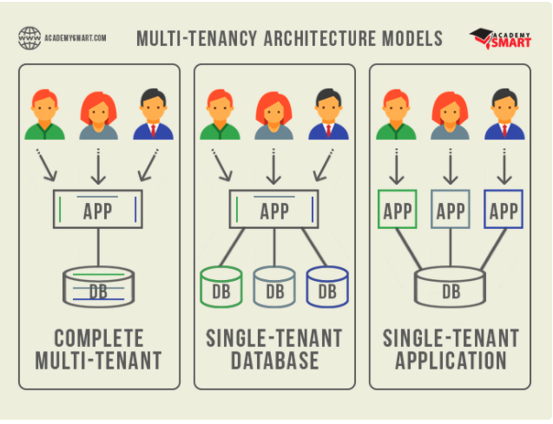
Multi-tenancy Architecture Models

Slide 29
Common characteristics of multitenant applications
Isolation: behavior of one tenant does not affect the availability and performance of other tenant.
Data Security: tenants cannot access data that belong to other tenant.
Recovery: backup and restore are separately executed for each user
Application upgrades: tenants are not negatively affected by upgrading.
Scalability: increased usage by existing tenants and/or increase in the number of tenants.
Metered usage: tenants are charged for only what they used
Data tier isolation: tenants have separate databases.
Example: most SaaS implementations.

Slide 30
Cloud-Enabling Technology
The following is a set of primary technology components that collectively enable key features and characteristics associated with contemporary cloud computing
Broadband network and Internet Architecture
Web Technology
Multitenant Technology
Service technology -- more details in an upcoming lecture
Data Center Technology
(Modern) Virtualization Technology -- details in the second part of this lecture

Slide 31
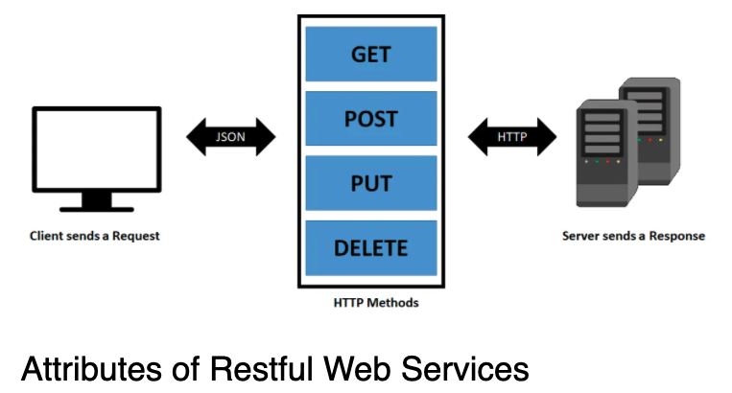
Cloud-Enabling Technology (4/6) Service technology
Service technology is the keystone foundation of cloud computing that formed the basis for “as-a-service”
Machine-callable APIs
Programmable Web: https://www.programmableweb.com/category/all/apis
Web-based Services:
standard communication and technical interface definitions based on web technologies
Two standards:
SOAP (Simple Object Access Protocol) services
REST (REpresentational State Transfer) services

Slide 32
Web-based Services
A web-based service is a self-contained unit of logic that support interoperable machine-to-machine interaction over a network.
Designed to communicate via non-proprietary technologies in accordance with industry standards and conventions.
their sole function is to process data between computers
Expose API (do no have user interfaces)
Two forms:
SOAP-based web services
REST-based web services

Slide 33
SOAP-based Web Services
A common medium for sophisticated, web-based service logic
Represented by the following industry standards for the core technologies:
Web Service Description Language (WSDL)
a markup language used to define API and its individual functions (inputs + outputs)
XML Schema Definition Language (XML Schema)
used to represent messages exchanged between services
XML schemas are directly linked to WSDL
SOAP – Simple Object Access Protocol
a standard that defines a common messaging (header + body) format used to request and response messages exchanged by Web services.
Universal Description, Discovery, and Integration (UDDI)
a standard that regulates service registries in which WSDL definitions can be published as part of a service catalog for discovery purposes.

Slide 34
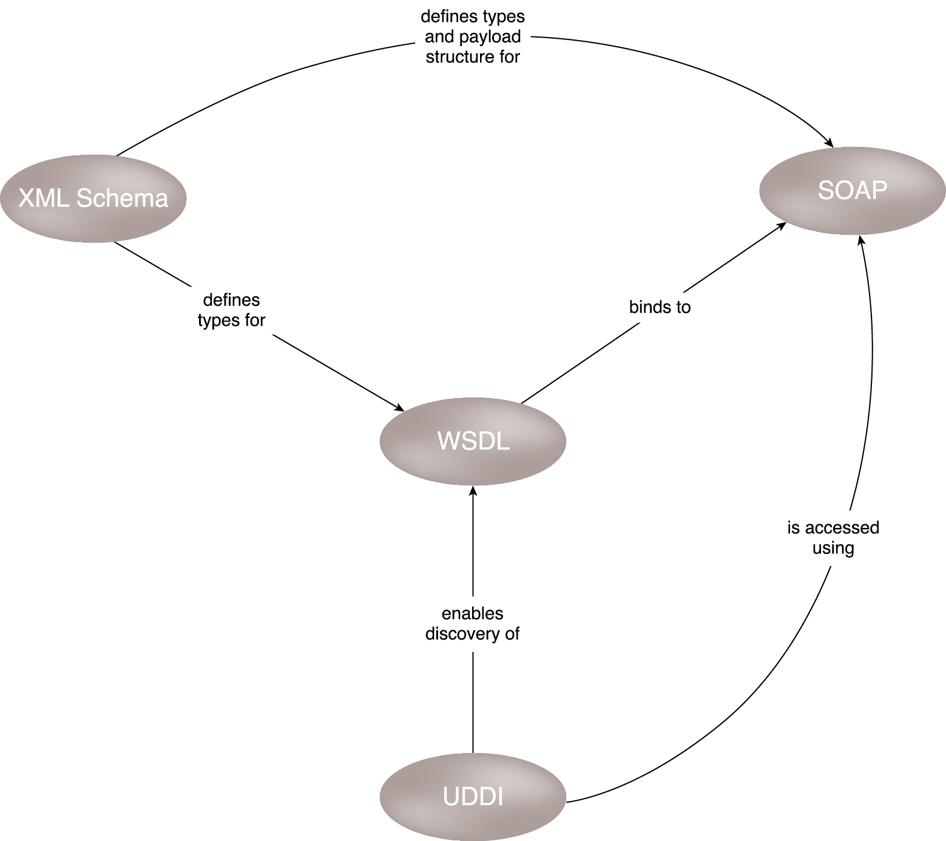
SOAP Services illustrated

Slide 35
REST Services
REST services’ implementation rely on the use of core Web technologies.
Unlike SOAP-based web services, REST services do not have individual technical interfaces but instead share a common technical interface that is known as the uniform contract, which is typically established via the use of HTTP methods.

Slide 36
Service Agents
Service Agents are event-driven programs designed to intercept messages at runtime.
Active agent: perform an action upon intercepting and reading the contents of a message.
making changes to the message contents or message path
Passive agent: do not change message contents.
capture parts of the message for monitoring, logging, or reporting.
In the cloud, service agents are used to perform the runtime monitoring and measuring required to ensure features like elastic scaling and pay-for-use billing can performed instantaneously.

Slide 37
Cloud Enabling Technologies
The following is a set of primary technology components that collectively enable key features and characteristics associated with contemporary cloud computing
Broadband network and Internet Architecture
Web Technology
Multitenant Technology
Service technology -- more details in an upcoming lecture
Data Center Technology
(Modern) Virtualization Technology -- details in the second part of this lecture

Slide 38
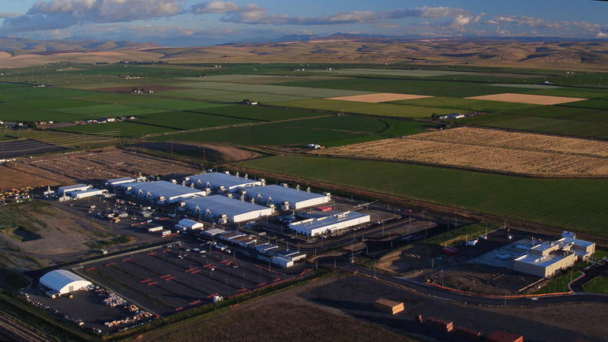
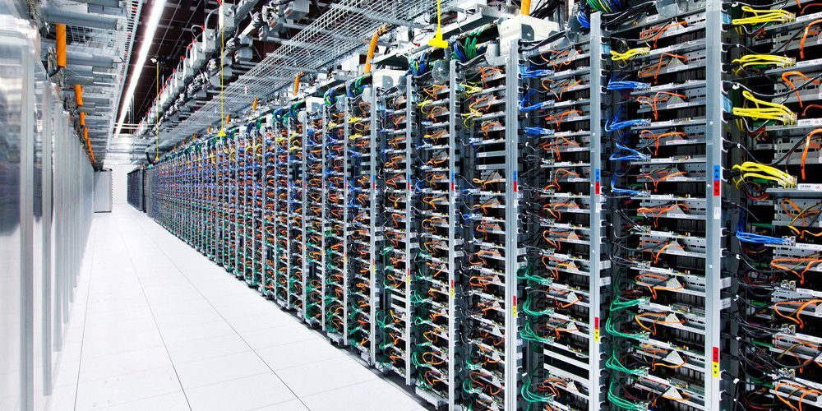
How a Data Center looks like?
Outside
Inside
Microsoft's datacenters dwarf the small Eastern Washington town of Quincy.
https://www.zdnet.com/article/photos-a-tour-inside-one-of-microsofts-cloud-data-centers/

Slide 39
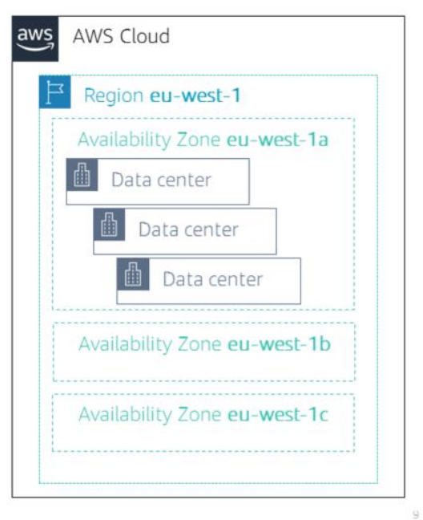
Cloud Enabling Technologies (5/6) Data Center technology
A data center is a way to grouping IT resources in close proximity with one another, rather than having them geographically dispersed.
IT resources included in the data center:
servers, databases, networking and telecommunication devices, and software systems
Advantages:
power sharing
improved accessibility for IT personnel
higher efficiency in shared IT resource usage

Slide 40
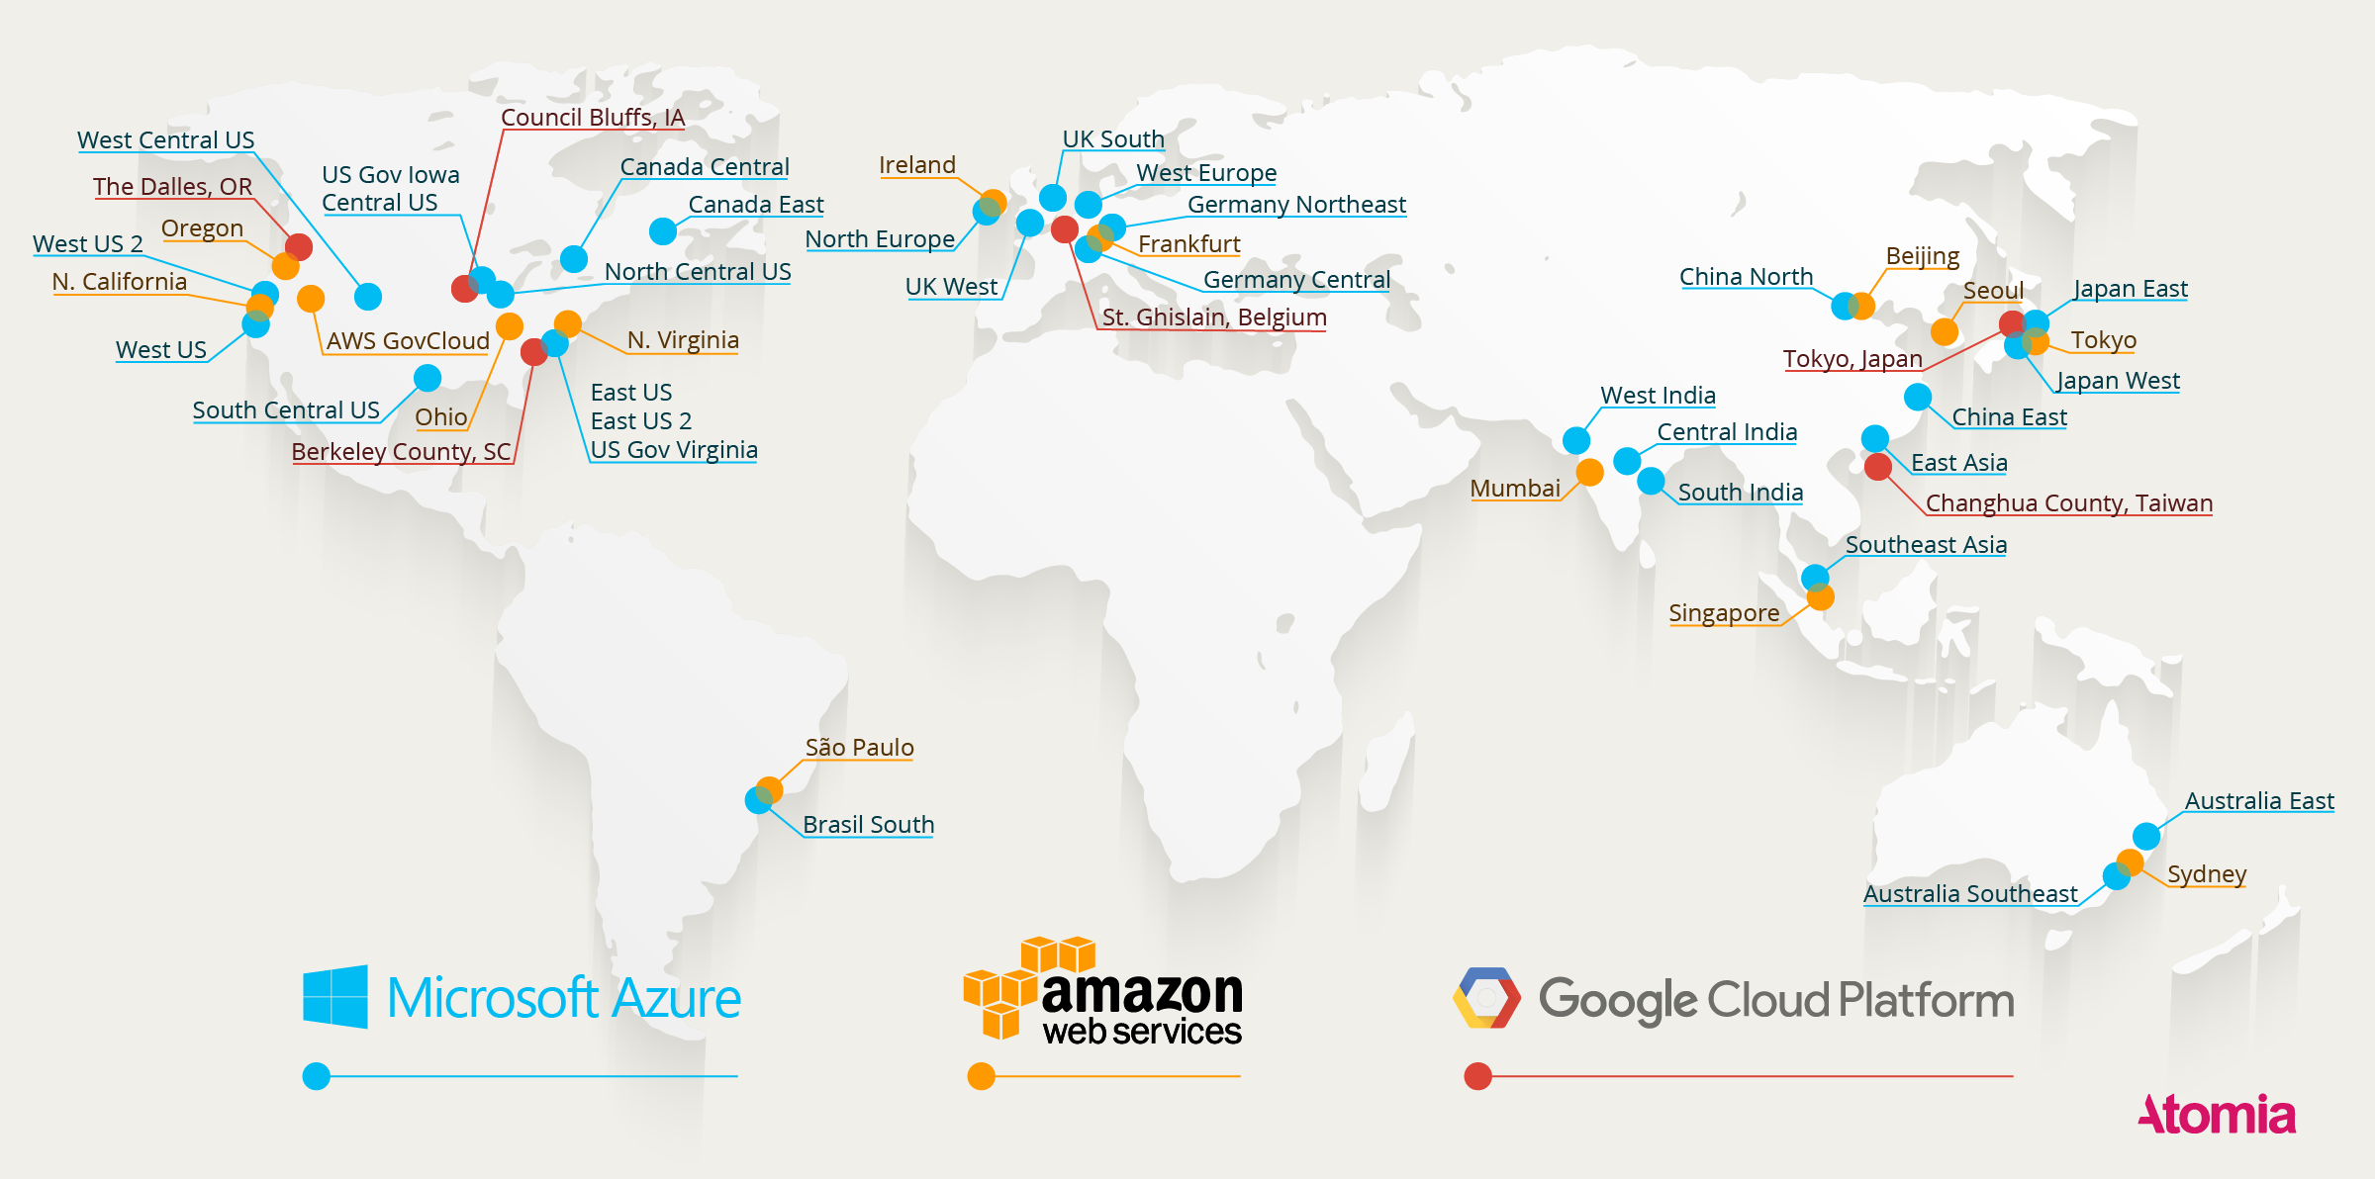
Google, Amazon, and Microsoft Datacenters (as of 2016)
https://www.atomia.com/2016/11/24/comparing-the-geographical-coverage-of-aws-azure-and-google-cloud/
Notes:
https://www.datacenterknowledge.com/archives/2016/09/21/heres-a-map-of-all-azure-and-aws-data-centers

Slide 41
What does a Data Center Look like from inside
Inside Google’s Data center:
https://www.youtube.com/watch?v=XZmGGAbHqa0
Microsoft GFS Datacenter Tour (Youtube) https://www.youtube.com/watch?v=KG4cE362ETE
Timelapse of a Datacenter Construction on the Inside (Fortune 500 company)
https://www.youtube.com/watch?v=ujO-xNvXj3g

Slide 42
Data Center Discussion
Data Center Technologies
Data Center Facilities
Data Center Issues
Data Center Standards by Telecommunication Industry Association (TIA):
TIA-942 standard for constructing data centers

Slide 43
Data Center Discussion
Data Center Technologies
Data Center Facilities
Data Center Issues
Data Center Standards by Telecommunication Industry Association (TIA):
TIA-942 standard for constructing data centers

Slide 44
Datacenter Technologies
Data centers are comprised of the following technologies and components:
Virtualization
Standardization and Modularity
Automation
Remote Operation and Management
High Availability
Security-aware Design, Operation, and Management

Slide 45
Datacenter Technologies (1) Virtualization
A datacenter consists of two layers of resources
Physical resources:
Hardware equipment + their operating systems
Virtualized resources:
Virtualization platforms that abstracts the physical equipment into virtualized components
Virtualized components are easy to allocate, operate, release, monitor, and control.

Slide 46
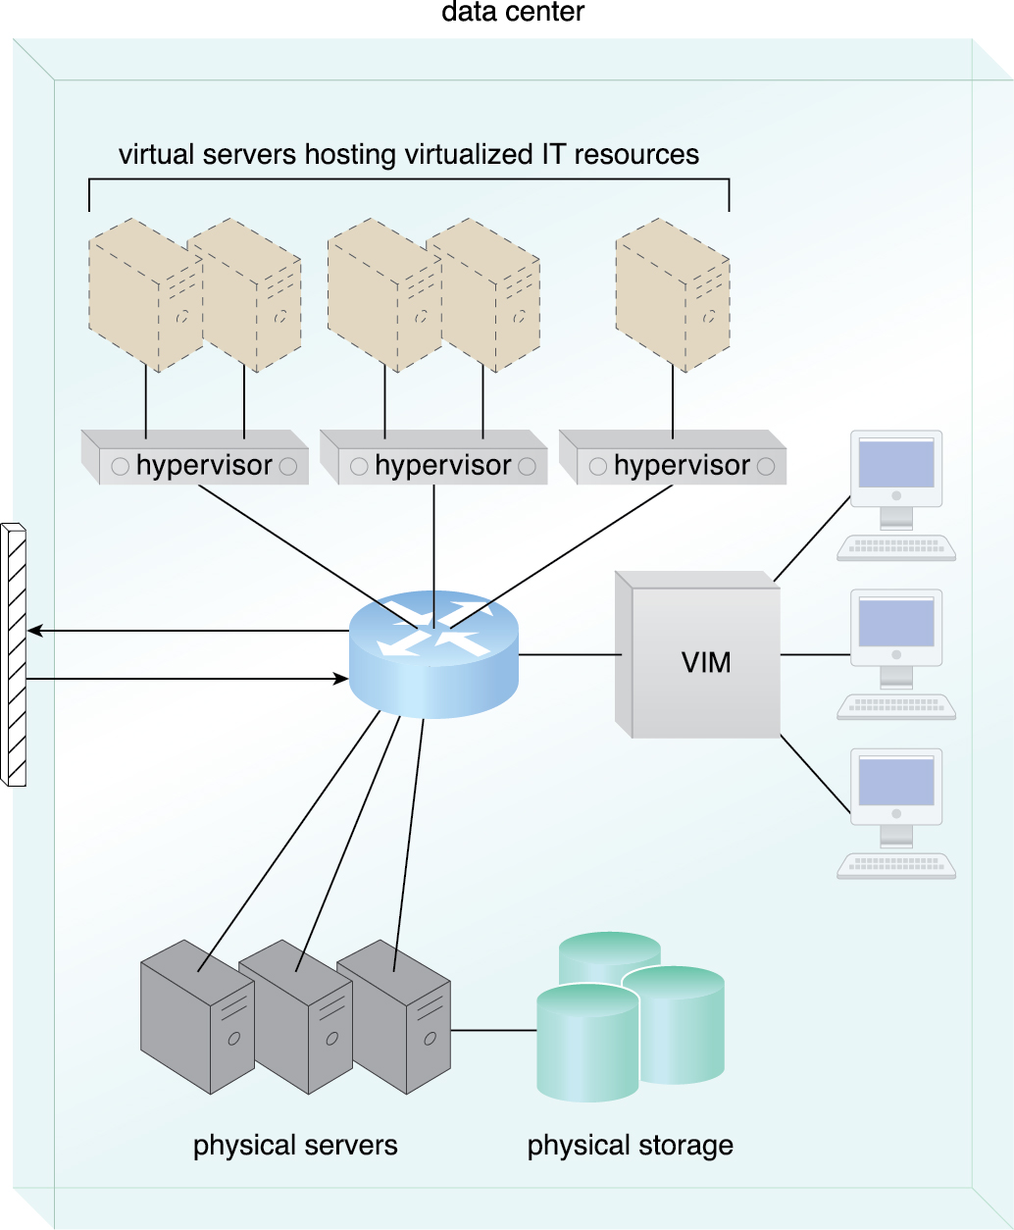
The common components of a data center working together to provide virtualized IT resources supported by physical IT resources.

Slide 47
Datacenter Technologies (2) Standardization & Modularity
Datacenters are built upon standardized commodity hardware.
Modularity and standardization are key requirements for reducing costs and enabling economics of scale for the procurement, operation, and maintenance processes.
Multiple identical blocks of equipment are aggregated to support:
scalability
growth
speedy HW replacement
Telecommunication Industry Association (TIA) provides the TIA-942 standard for constructing data centers

Slide 48
Standardization & Modularity (continued)
IT resource consolidation refers to consolidating multiple tasks or operations into a single computational unit (i.e., fewer physical components are needed to support complex configurations).
Benefits of consolidation:
reduce costs,
increase utilization,
improve communication speed, and
reduce management

Slide 49
Datacenter Technologies (3) Automation
Datacenters have specialized datacenter management platforms to automate tasks like:
Provisioning
Configuration
Patching
Monitoring
Autonomic Computing technologies enable:
Self-configuration
Self-recovery
Notes:
Autonomic: having autonomy; not subject to control from outside; independent

Slide 50
Autonomic Computing
Autonomic computing refers to the ability of a computer system to self-manage.
Four capabilities:
Self-configuration – accommodate varying and unpredictable conditions
Self-healing – remain functioning when problems arise
Self-protection – detect threats and take appropriate actions
Self-optimization – constant monitoring for optimal operation

Slide 51
Autonomic computing in the cloud
Elasticity
Monitor usage conditions
Leverage cloud-based IT resources to automatically acquire and free IT resources as needed for the purpose of maintaining the required service level.
Resiliency
Automatically detect unavailable IT resources
Self-respond to allocate alternative IT resources as required.
Automated Scaling Listener

Slide 52
Datacenter Technologies (4) Remote Operation & Management
Operational and administrative tasks of IT resources in the data center are commanded through the Network’s remote consoles and management systems.
Technical personnel are not required to visit the dedicated rooms that house servers, except to perform highly specific tasks
equipment handling
Cabling or Hardware-level installation and maintenance

Slide 53
Datacenter Technologies (5) High Availability
Datacenter outage significantly impacts business continuity.
Datacenters are designed to operate with increasingly higher levels of redundancy to sustain availability
Redundant, uninterruptable power supplies, cabling
Environmental control sub-systems
Communication links and clustered hardware for load balancing.

Slide 54
Datacenter Technologies (6) Security-aware Design, operation, & Management
Comprehensive physical and logical access control and data recovery strategies are needed for data centers since they are centralized structures that store and process business data.
Outsourcing datacenter-based IT resources has been a common industry practice because of the ‘sometimes’ prohibitive nature of building and operating on premise.
outsourcing requires long-term consumer commitment.
Clouds offers a more efficient option than outsourcing:
inherent features like ubiquitous access, on-demand provisioning, rapid elasticity, and pay-per-use

Slide 55
Data Center Discussion
Data Center Technologies
Data Center Facilities
Data Center Issues
Data Center Standards by Telecommunication Industry Association (TIA):
TIA-942standard for constructing data centers

Slide 56
Data Center Facilities
Computing Hardware
Storage Hardware
Network Hardware
Considerations

Slide 57
Computing Hardware
Standardized commodity servers with substantial computing power and storage capacity.
Several HW technologies include:
rackmount form factor server design composed of standardized racks with interconnects for power, network, and internal cooling.
Support for different hardware processing architectures,
A power-efficient multi-core CPU architecture that houses hundreds of processing cores in a space as small as single unit of standardized racks
redundant and hot-swappable components such as hard disks, power supplies. network interfaces, and storage controller cards.

Slide 58
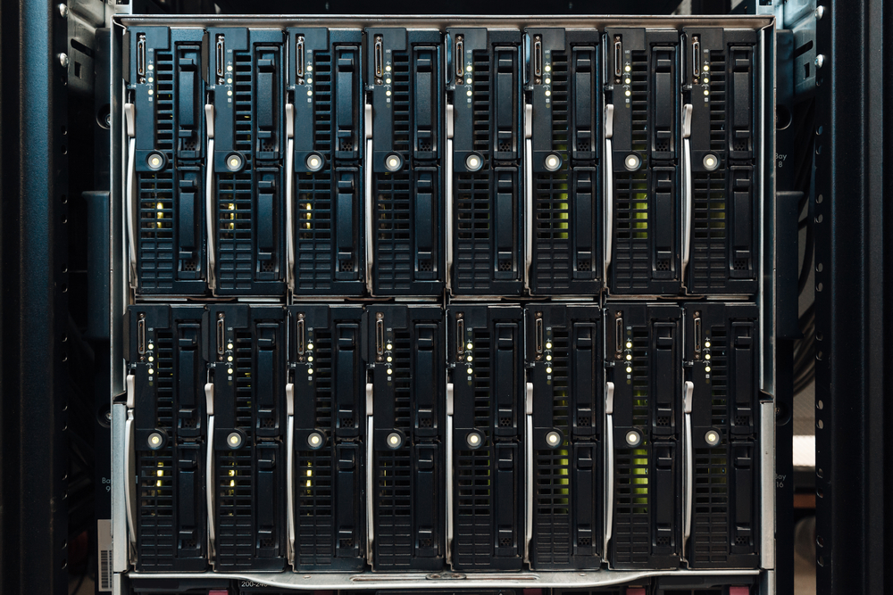
Computing HW: Blade Servers
Blade Server technologies:
rack-embedded. physical interconnections (blade enclosures)
fabrics (switches)
shared power supply units
cooling fans
Used for the deployment of fault-tolerant systems that are based on computer clusters.
Support operational and management software systems that configure, monitor, and control HW from remote management consoles.
a single operator can oversee thousands of physical servers, virtual servers, and other IT resources.

Slide 60
Servers illustrated
Front
Back

Slide 61
Inside
Highly Secure

Slide 62
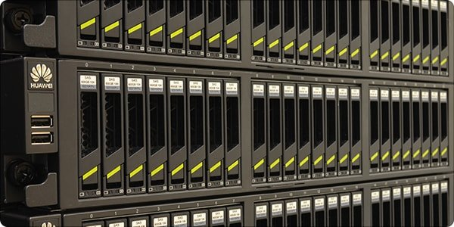
Storage Hardware Technologies
Hard Disk Arrays: inherently divide and replicate data among multiple physical drives. Example: Redundant Arrays of Independent Disks (RAID)
I/O caching: hard disk array controllers to enhance disk access times
Hot-swappable hard disks: can be safely removed from arrays without requiring prior powering down.
Storage virtualization
Fast Data replication mechanisms
Snapshotting – saving a virtual machine’s memory into a hypervisor-readable file for future loading

Slide 63
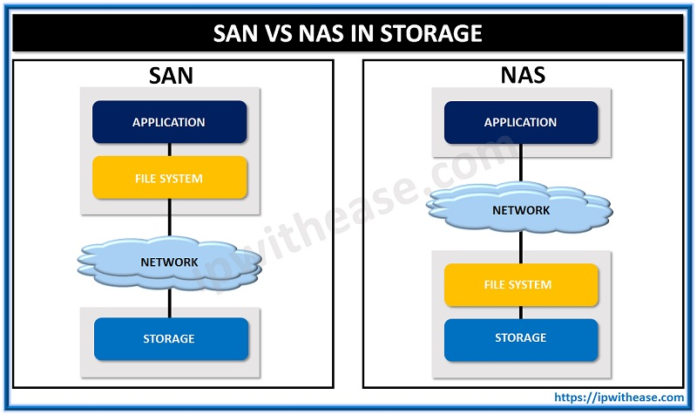
Networked storage devices
Storage Area Network (SAN)
physical data storage media are connected through a dedicated network
provide block-level data storage access using industry standard protocols.
Network-attached Storage (NAS)
a dedicated device to contain and manage hard drive arrays
connects through a network and facilitates access to data using file-centric data access protocols like Network File System (NFS)

Slide 64
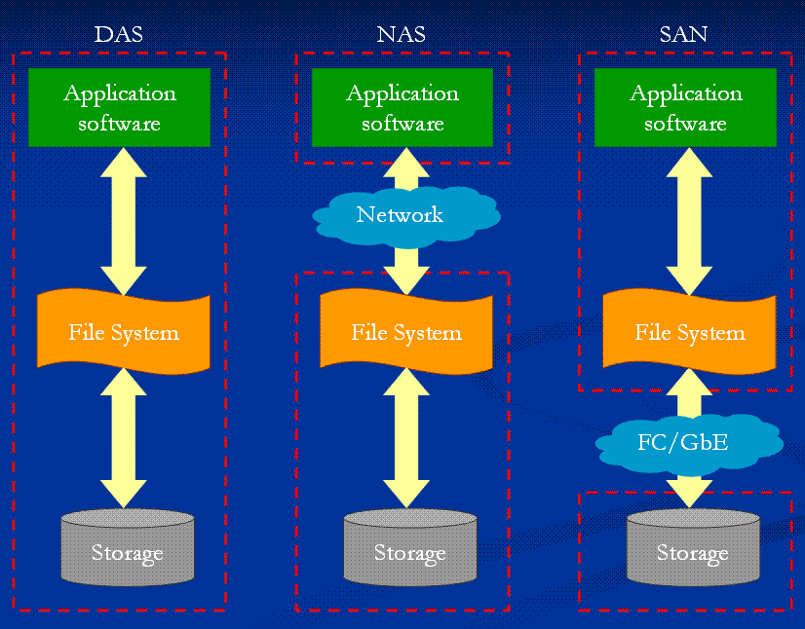
Notes:
https://simple.wikipedia.org/wiki/Storage_area_network#/media/File:Compingles2.png

Slide 65
Network Hardware
Data centers require extensive network hardware
A data center is broken down into five network subsystems
Carrier and external network interconnection
routers between external WAN and the data center’s LAN
Web-tier load balancing and acceleration
layer 7 switching devices that perform content-aware rounting
LAN Fabric
internal LAN for all data center’s networked-enabled IT resources.
10 gigabits/sec
provide network virtualization
SAN Fabric
connectivity between servers and storage systems
NAS Gateway
supplies attachment points for NAS-based storage devices
supports data transmission between SAN and NAS devices.

Slide 66
HW Considerations
IT hardware is subject to rapid technological obsolescence
lifecycles that typically last between five to seven years
Heterogeneous HW:
the on-going need to replace equipment frequently results in a mix of HW whose heterogeneity can complicate the entire data center’s operations and management.
Security:
housing data exclusively at one data center facility means much more can be compromised by a successful security incursion than if data was distributed across individual unlinked components.

Slide 67
Data Center Conclusions (1)
A data center is a specialized IT infrastructure that houses centralized IT resources, such as servers, databases, ad software systems.
Data center IT HW is typically comprised of standarized commodity servers of increased computing power and storage capacity.

Slide 68
Data Center Conclusions (2)
Storage system technologies include disk arrays and storage virtualization. Technologies to increase storage capacity include DAS, SAN, and NAS.
Computing HW technologies include rack-mounted server arrays and multi-core CPU architectures
High-capacity Network HW technology include content-aware routing, LAN and SAN fabrics, NAS gateways.

Slide 69
Data Center Discussion
Data Center Technologies
Data Center Facilities
Data Center Issues
Data Center Standards by Telecommunication Industry Association (TIA):
TIA-942standard for constructing data centers

Slide 70
Major Datacenter Issues (1)
Storage requirements:
heavy demands on the storage infrastructure as applications increasingly involve access to massive data sets.
Varying network requirements:
Streaming large amounts of data (from disks or SSDs) requires low-latency, high speed networks
Inter-process communication (e.g., for synchronizations and data exchange) requires very low-latency.
Accessing data at remote sites.
Carrying the different data on the same network requires sophisticated QoS.
Notes:
Source: Data Center Evolution paper: Section 1.5
http://bnrg.cs.berkeley.edu/~randy/Courses/CS294.S13/1.3.pdf

Slide 71
Major Datacenter Issues (2)
Configuration management is a vital component for the smooth operation of the data center
Required at multiple levels
Servers
Virtualization requires management at the logical (rather than physical).
Effective real-time management of large heterogeneous data centers becomes quite complex.
Challenges in power and thermal management:
High utility cost
Environmental impact as a result of increased power consumption
Requires power, cooling, and thermal control techniques at multiple levels
Power/thermal management affects performance.

Slide 72
Major Datacenter Issues (3)
Security issues:
Security must be implemented such that so that no single compromise can provide access to a large number of machines or a large amount of data.
Virtualization allows multiple users to use the same machines and hence intruders could well be those sharing the same physical infrastructure.
Virtualization can be exploited for disruption and denial of service.

Slide 73
Data Center Discussion
Data Center Technologies
Data Center Facilities
Data Center Issues
Data Center Standards by Telecommunication Industry Association (TIA):
TIA-942standard for constructing data centers

Slide 74
TIA-942 Data Center Standard
TIA-942: Data Center Standard
https://www.accu-tech.com/hs-fs/hub/54495/file-15894024-pdf/docs/102264ae.pdf
https://www.ieee802.org/3/hssg/public/nov06/diminico_01_1106.pdf
TIA: Telecommunication Industry Association

Slide 75
Telecommunication Infrastructure Standard for Data Centers (TIA – 942)
The purpose is to define a standard telecommunications infrastructure for data centers
Structured cabling system for data centers using using standardized architecture and media
Accommodates a wide range of applications (LAN, WAN, SAN, channels, consoles)
Accommodates current and future protocols (e.g., 10+ GbE )
Replaces unstructured point-to-point cabling that uses different cabling for different applications

Slide 76
TIA-942 Purpose (continued)
Specifications for data center telecommunications pathways and spaces
Recommendations on media and distance for applications over structured cabling
Establish a standard for data center tiers to replace several proprietary standards.
The TIA data center tier standard is:
A tool to evaluate existing data centers
A tool to communicate design requirements

Slide 77
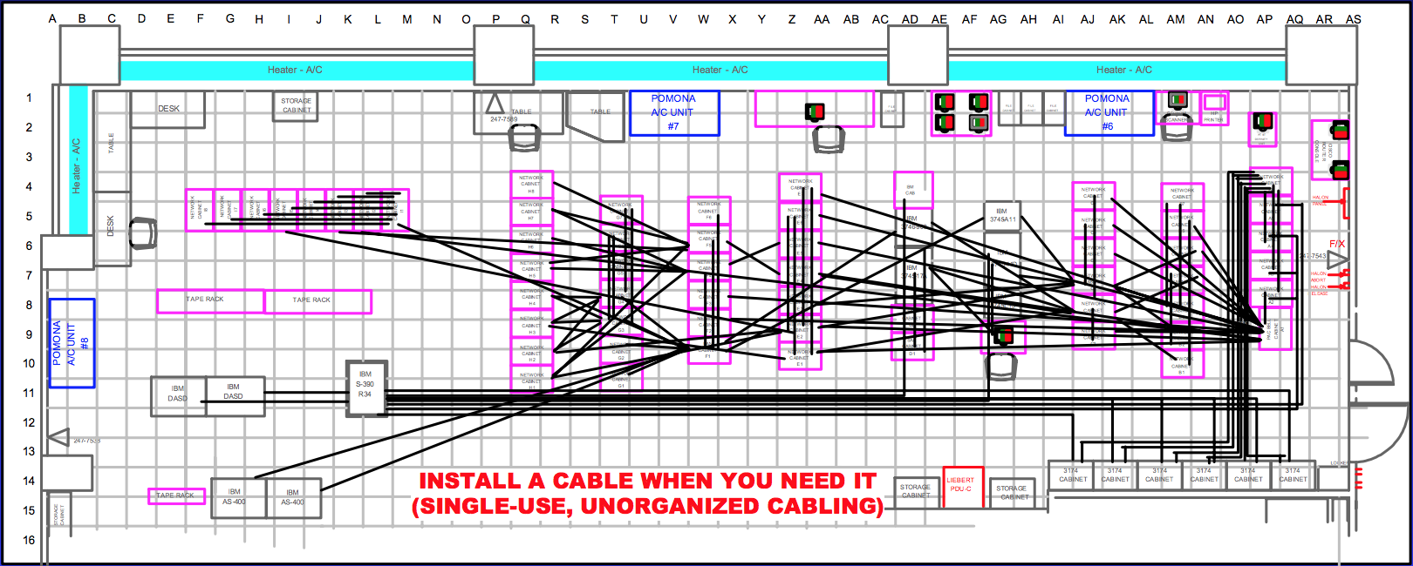
Unstructured Cabling

Slide 78
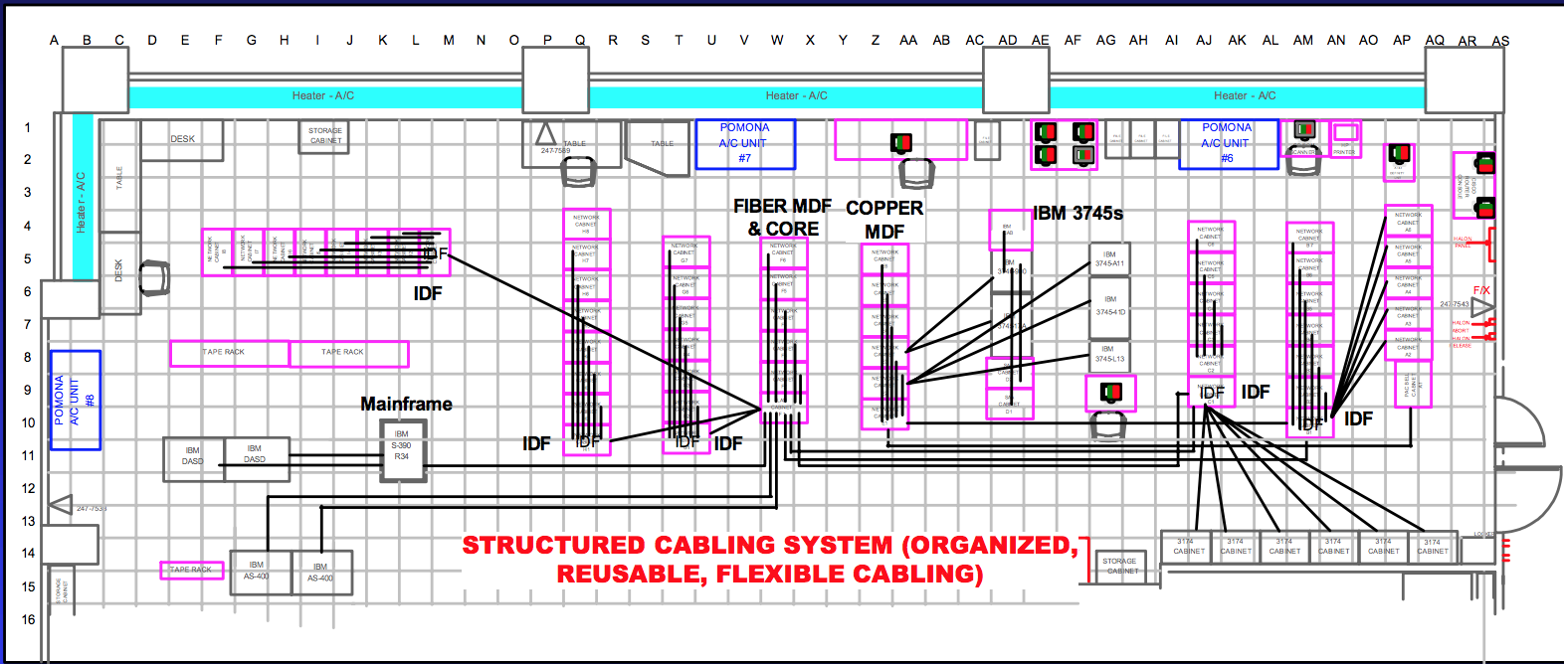
Structured Cabling

Slide 79
TIA-942’s Three Design Elements
Cabling Design
Copper and fiber cabling performance
Connectors, cables, distribution hardware
Cabling distances
Space management
Facility Design
Data center sizing
Power distribution methodologies
Pathways and spaces
HVAC, security, operations, and administration.
Flexibility, scalability, reliability and space management
Network Design
Support of legacy systems
Enable rapid deployment of new and emerging technologies such as 10 GbE and 10+ GbE copper and fiber applications.

Slide 80
Primary Rooms in a Data Center
Electrical Room
Mechanical Room
Storage and Staging
Offices, Operations center, and support
Telecommunication Entrance
Computer Room

Slide 82
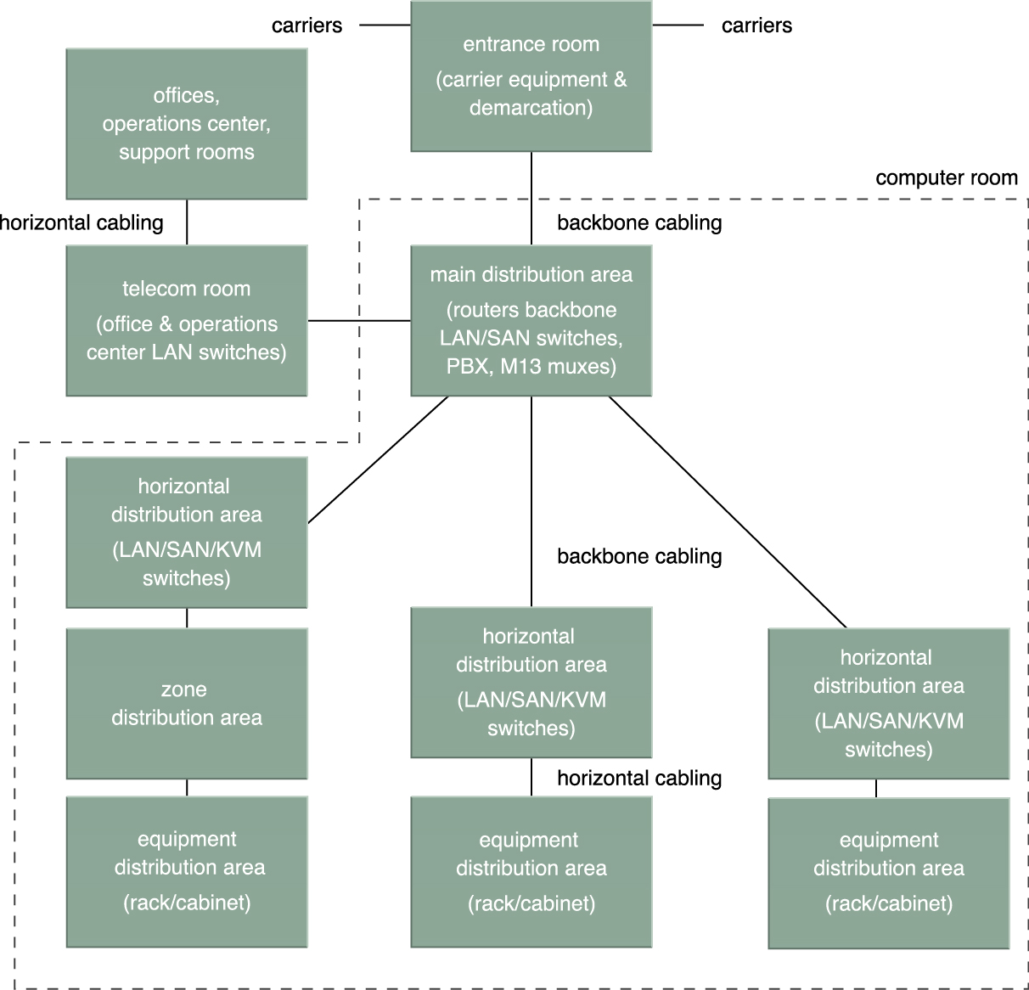
A data center’s internetworking regions, divided into backbone and horizontal cablings (adapted from TIA-942).

Slide 83
Computer Room
A highly critical zone with strict environmental control and access that is limited to authorized personnel.
Usually has raised floors and safety vaults that are designed to protect the data center equipment from physical hazards.
Three specialized areas:
Main Distribution Area (MDA) – backbone telecom and network equipment
Horizontal Distribution Area (HDM) – network, storage, and KVM switches
Equipment Distribution Area (EDM) – computing and storage equipment
Standardized rack cabinets
Horizontal cabling for individual equipment connect
Notes:
KVM switch = Keyboard, Video, and Mouse Switch. A KVM Switch is a hardware device, used in data centers, that allows the control of multiple computers from a single keyboard, monitor and mouse (KVM). This switch then allows data center personnel to connect to any server in the rack.

Slide 84
Environmental Control
Fire suppression
Humidification/dehumidification
Heating
Ventilation
Air condition (HVAC)
Controlling the airflow is crucial in order to handle the significant amounts of heat generated by the server racks.

Slide 86
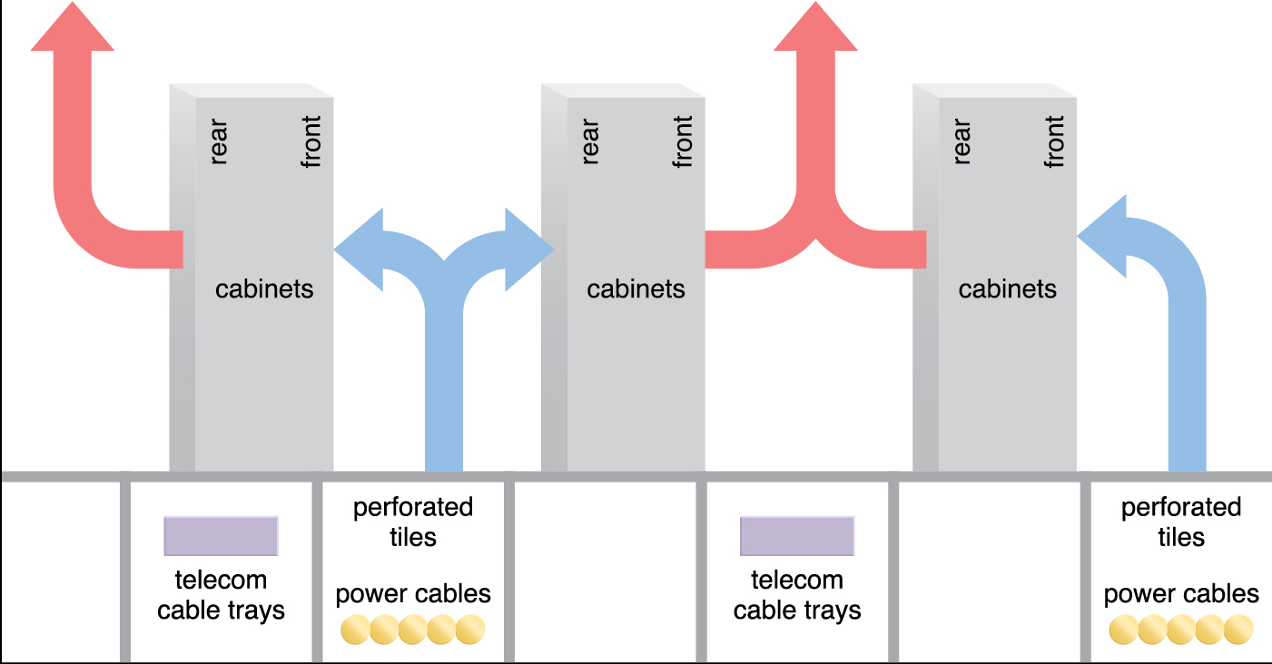
A depiction of the flow of cold and hot air that accommodates server racks in a typical data center design. The hot air generally leaves the room through ceiling air ducts (adapted from TIA-942)

Slide 87
Datacenter Organization
Can be divided into four major areas
Rack-level physical organization
Storage & Networking infrastructure
Management Infrastructure
Electrical & Cooling infrastructure

Slide 88
Cloud Enabling Technologies
The following is a set of primary technology components that collectively enable key features and characteristics associated with contemporary cloud computing
Broadband network and Internet Architecture
Web Technology
Multitenant Technology
Service technology -- more details in an upcoming lecture
Data Center Technology
(Modern) Virtualization Technology

Slide 89
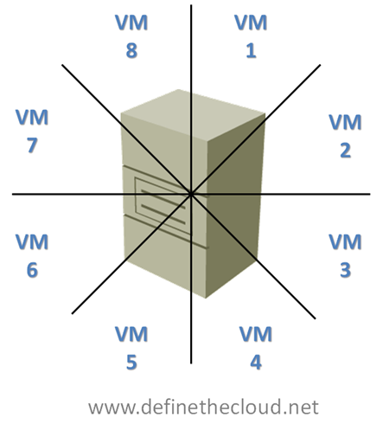
Cloud Enabling Technologies (6/6) Virtualization
Virtualization is the process of converting a physical IT resource into several virtual IT resources
The following IT resources can be virtualized:
Servers
Storage
Network:
physical routers and switches can be abstracted into logical network fabrics, such as VLANs.
Power:
a physical UPS and power distribution units can be abstracted into what are commonly referred to as virtual UPSs.

Slide 90
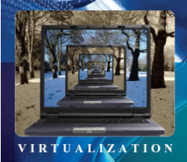
Virtualization is the Backbone of Cloud Computing

Slide 91
Short videos
Server Virtualization: http://www.youtube.com/watch?v=p11lJOnALS4&featur e=related
Storage Virtualization
https://www.youtube.com/watch?v=vURnIkGOrp4

Slide 92
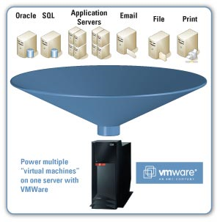
Virtualization
The division of a single physical server into multiple “virtual” servers is the backbone of Cloud Computing as it allows for far greater flexibility and resource utilization.
Virtualization also saves electric power, space and cooling since the number of physical server machines running is greatly reduced.
Source: escope.net

Slide 93
We will address the following topics
Why virtualization?
Characteristics of Virtualized Environments.
Computer System operation.
How virtualization is implemented.

Slide 94
Key words
Server Consolidation
Live Migration
Managed execution
Performance tuning
Dual-mode of operation (privileged and non-privileged instructions)
Instruction Set Architecture (ISA)
Multiprogramming vs. multitasking
Hypervisors, guest, host
Paravirtualization
Programming-environment virtualization

Slide 95
Introduction to Virtualization
Virtualization is a large umbrella of technologies and concepts that are meant to provide an abstract environment to run applications
Hardware virtualization, which plays a fundamental role in efficiently delivering Infrastructure-as-a-Service (IaaS) solutions for cloud computing.
Virtualization technologies provide a virtual environment for not only executing applications but also for storage, memory, and networking.

Slide 96
Why virtualization? (1/2)
Underutilized hardware and software resources due to:
increased performance and computing capacity
limited and sporadic use of resources.
An IT infrastructure can be used without interruption 24/7/365.
PCs are unused over night --> can be used after hours to improve efficiency of IT infrastructure.
Lack of Space:
data centers grow quickly
Server consolidation is a technique for aggregating multiple services and applications originally deployed on different servers on one physical server.
Server consolidating helps to reduce the power consumption of a data center and resolve hardware underutilization.

Slide 97
Why virtualization? (2/2)
Greening initiatives
reduce energy consumption to reduce carbon footprint.
Infrastructures for cooling have a significant impact on the carbon footprint of a data center.
reducing the number of servers through server consolidation will reduce the impact of cooling.
Rise of administrative costs.
labor-intensive system administration tasks include: hardware monitoring, defective hardware replacement, server setup and updates, server resources monitoring, and backups.

Slide 98
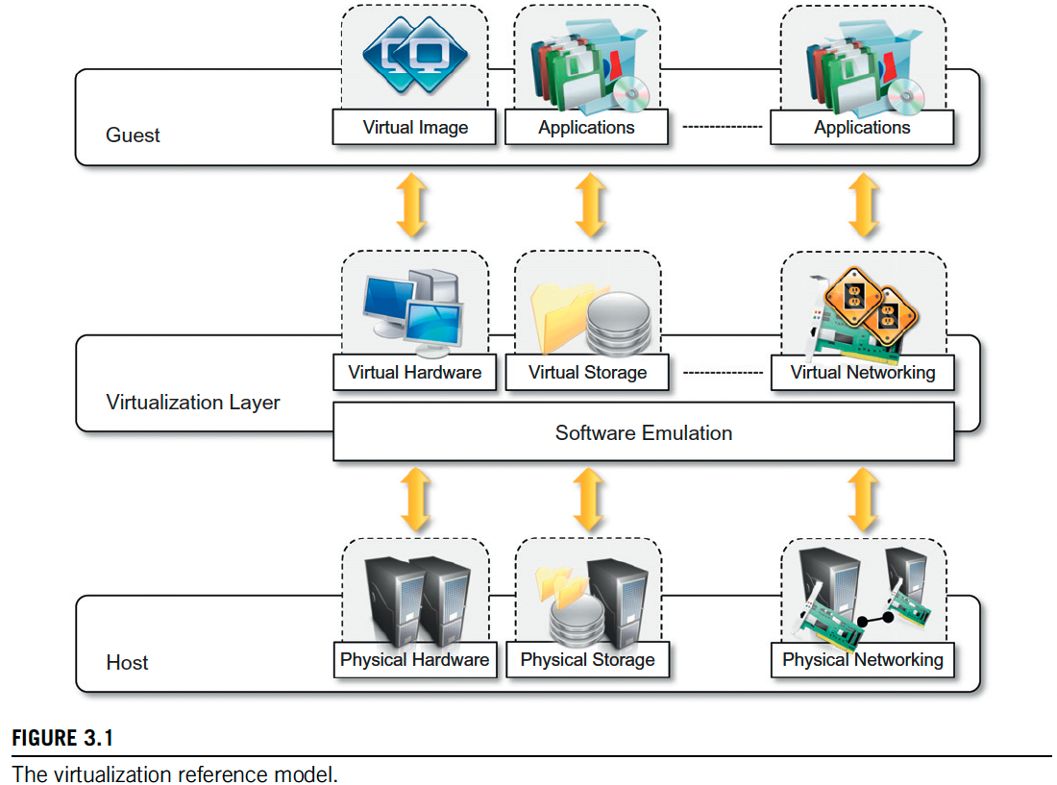
Virtualized Environment
A virtualized environment has three major components:
Guest -- the system component that interacts with the virtualization layer
Virtualization layer -- responsible for recreating the same or a different environment where the guest will operate
Host -- represents the original environment where the guest is supposed to be managed.
The virtual environment is created by means of a software program to emulate the host.

Slide 99
Different Virtualization environment
Hardware virtualization
guest: system image comprising an operating system and installed applications
virtualization layer: virtual machine manager
host: physical hardware
Storage virtualization:
guest: applications or users
virtualization layer: virtual storage management software (software-defined storage)
host: real storage system

Slide 100
Characteristics of Virtualized Environments
Increased Security
Managed execution
Portability

Slide 101
Increased Security
All the operations of the guest are generally performed against the virtual machine, which then translates and applies them to the host.
The guest is running in a controlled execution environment
VMM can filter the activity of the guest, thus preventing some harmful operations from being performed.
Host resources/sensitive information are hidden and protected from the guest.
Example: Java applets downloaded from the internet run in a Java Virtual Machine (JVM).

Slide 102
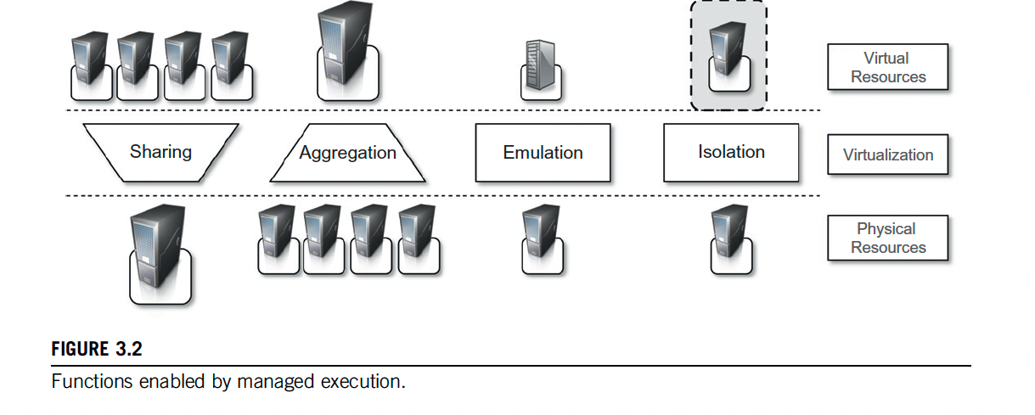
Managed Execution

Slide 103
Managed Execution (continued)
Sharing: creation of a separate computing environments within the same host.
fully exploit the capabilities of a powerful guest; server consolidation
Aggregation: a group of separate hosts can be tied together and represented to guests as a single virtual host
clusters; middleware for distributed computing
Emulation: a completely different environment with respect to the host can be emulated.
testing against a different environment; running legacy software that does. not meet the requirements of current systems.
Isolation: prevent harmful interaction between guests on the same machine.

Slide 104
Performance Tuning
Virtualization allows controlling the performance of the guest by finely tuning the properties of the resources exposed through the virtual environment.
expose to a guest operating system only a fraction of the memory
set the maximum frequency of the processor of the virtual machine
Implementing Quality of Service (QoS) and Service Level Agreement (SLA).

Slide 105
Live Migration
Migration constitutes an important feature in virtualized data centers for optimizing their efficiency in serving application demands.
Virtualization allows capturing of the state of the guest program, persisting it, and resuming its execution.
Hypervisor to stop the execution of a guest operating system, move its virtual image into another machine, and resume its execution in a completely transparent manner.

Slide 106
Portability
A guest is packaged into a virtual image that, in most cases, can be safely moved and executed on top of different virtual machines.
Virtual images are generally proprietary formats that require a specific virtual machine manager to be executed.
having all the applications and services you need available to you anywhere you go
Application development becomes cycle more flexible and application deployment very straightforward.

Slide 107
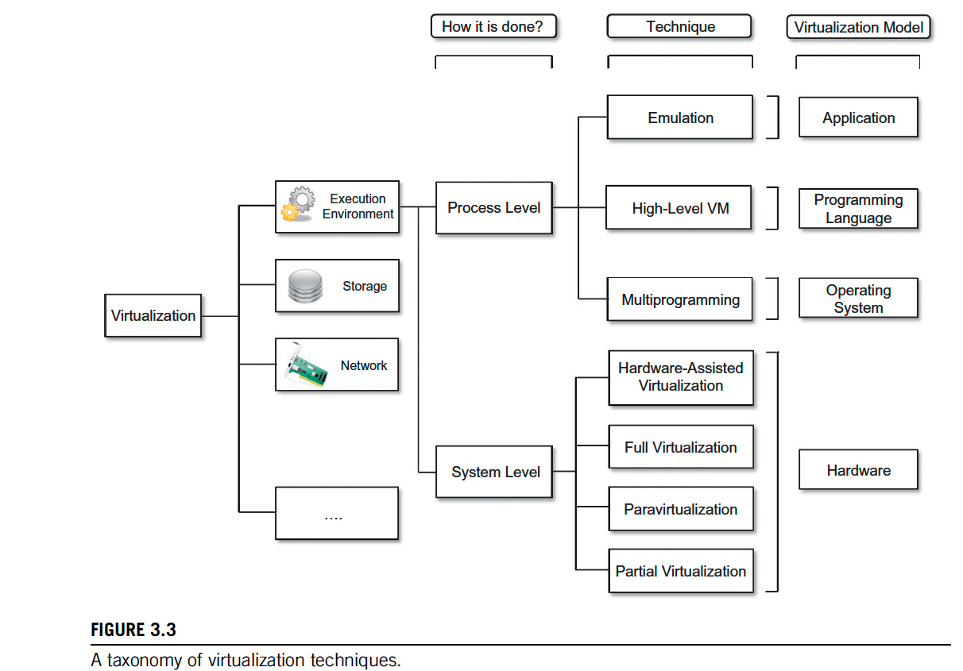
Taxonomy of Virtualization techniques

Slide 108
Execution Virtualization
Execution virtualization includes all techniques that aim to emulate an execution environment that is separate from the one hosting the virtualization layer.
Process level:
techniques are implemented on top of an existing operating system, which has full control of the hardware.
System level:
techniques are implemented directly on hardware and do not require—or require a minimum of support from—an existing operating system.

Slide 109
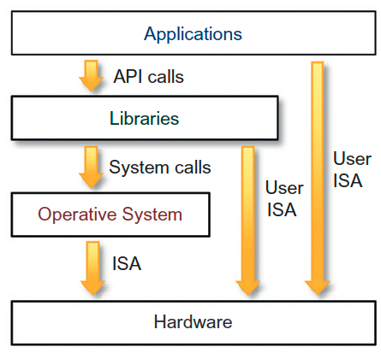
Machine Reference Model
A computer system is implemented using layers of abstractions which hides implementation details.
Virtualization techniques replace one of the layers and intercept the calls that are directed toward it.
Instruction Set Architecture (ISA) is the interface between hardware and software
Operating system (OS) is an interface between applications and hardware, and it uses ISA to execute its operations.

Slide 110
ISA
The high-level abstraction is converted into machine-level instructions to perform the actual operations supported by the processor.
The machine-level resources, such as processor registers and main memory capacities, are used to perform the operation at the hardware level of the central processing unit (CPU).
Since the operating system and the users share the hardware and software resources of the computer system, we need to make sure that an error in a user program could cause problems only for that one program running.

Slide 111
ISA classification
The instruction set exposed by the hardware has been divided into different security classes that define who can operate with them.
Nonprivileged instructions are those instructions that can be used without interfering with other tasks because they do not access shared resources
e.g., floating point arithmetic
Privileged instructions are those that are executed under specific restrictions and are mostly used for sensitive operations, which expose (behavior-sensitive) or modify (control-sensitive) the privileged state.
behavior-sensitive instructions are those that operate on the I/O.
control-sensitive instructions alter the state of the CPU registers.

Slide 112
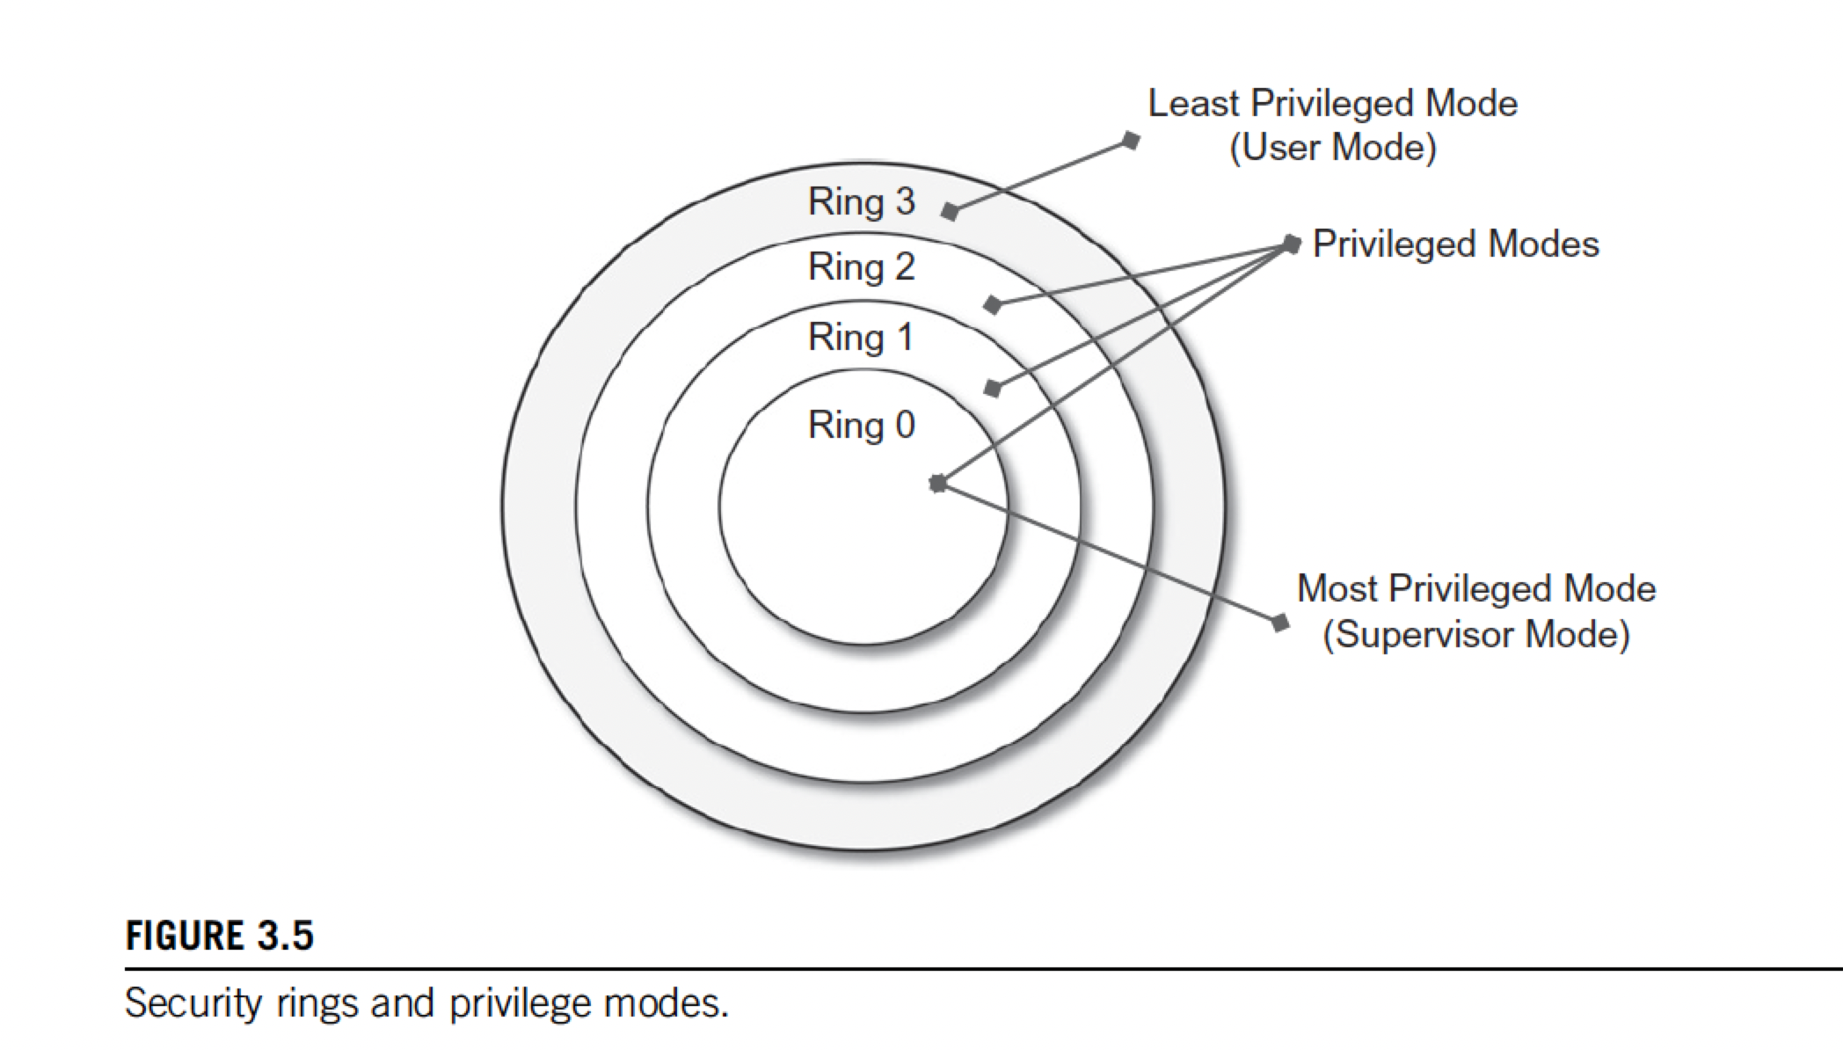
Hierarchy of privileges
Recent systems support only two levels:
Ring 0 for supervisor mode
all the instructions (privileged and nonprivileged) can be executed without any restriction
is generally used by the operating system (or the hypervisor) to perform sensitive operations on hardware level resources.
Ring 3 for user mode.
there are restrictions to control the machine-level resources.
If code running in user mode invokes the privileged instructions, hardware interrupts occur and trap the potentially harmful execution of the instruction

Slide 113
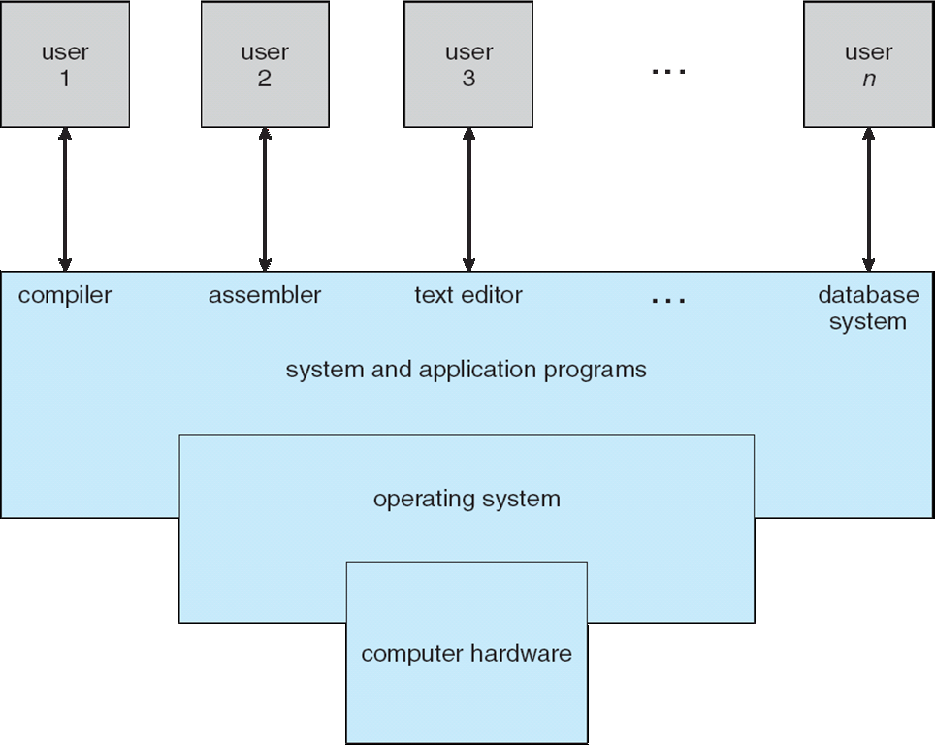
Computer System Architecture
To understand how virtualization works, we need to first understand how the computer work.

Slide 114
Operating-System Operations
The operating system is the heart of a computer system
Operating systems may differ based on the underlying computer architecture/hardware.
However, all operating systems share some basic operations that including process management and memory management

Slide 115
Types of Operating Systems
Two types of operating systems:
Multiprogramming
Multitasking

Slide 116
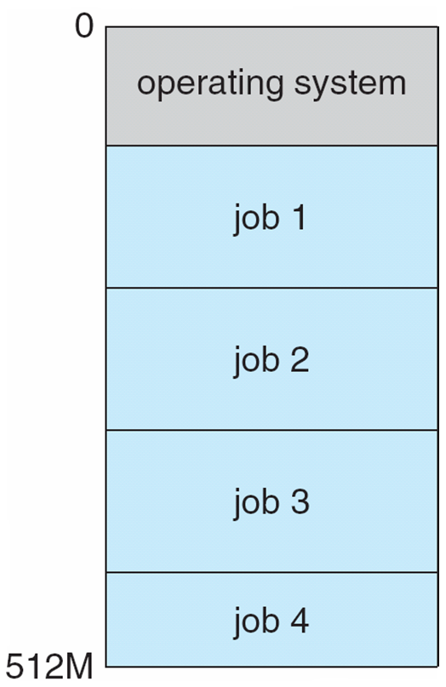
Types of Operating System: Multiprogramming
Multiprogramming (Batch system) needed for efficiency
Single user cannot keep CPU and I/O devices busy at all times
Multiprogramming organizes jobs (code and data) so CPU always has one to execute
A subset of total jobs in system is kept in memory
One job selected and run via job scheduling
When it has to wait (for I/O for example), OS switches to another job

Slide 117
Types of Operating Systems: Multitasking
Multiprogrammed systems provide an environment in which the various system resources (e.g., CPU, memory) are utilized effectively, but they do not provide for user interaction with the computer system.
Timesharing (multitasking) is a logical extension in which CPU switches jobs so frequently that users can interact with each job while it is running, creating interactive computing
Response time should be < 1 second
Each user has at least one program executing in memory process
If several jobs ready to run at the same time  CPU scheduling
If processes don’t fit in memory, swapping moves them in and out to run
Virtual memory allows execution of processes not completely in memory

Slide 118
Interrupts
An OS is Interrupt driven
Interrupts can be raised by either hardware and software
Hardware interrupt by one of the devices
Software interrupt (exception or trap):
Software error (e.g., division by zero)
Request for operating system service
Other process problems include infinite loop, processes modifying each other or the operating system

Slide 119
OS operates in Dual-mode
Dual-mode operation allows OS to protect itself and other system components
Two modes are: user mode and kernel (supervisor) mode
Mode bit provided by hardware
Provides ability to distinguish when system is running user code or kernel code
Some instructions designated as privileged, only executable in kernel mode
System call changes mode to kernel, return from call resets it to user

Slide 120
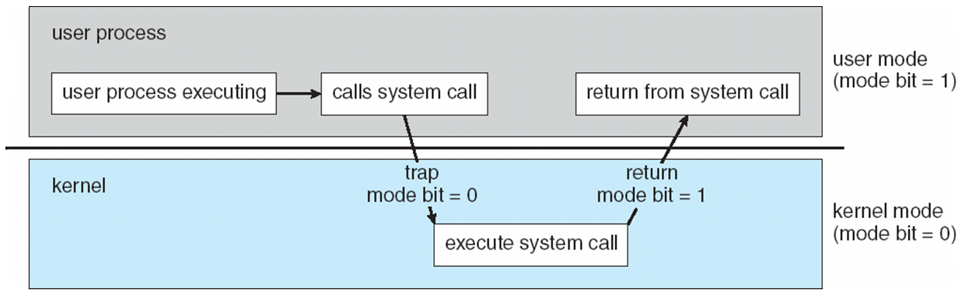
Dual-mode Illustrated

Slide 121
Modes of OS Operation
The concept of modes can be extended beyond two modes:
in which case the CPU uses more than one bit to set and test the mode.
CPUs that support virtualization have a separate mode to indicate when the virtual machine manager (VMM) is in control of the system.
In this mode, VMM has more privileges than user processes but fewer than kernel.

Slide 122
Timer
A timer is used to ensure that the operating system maintains control over the CPU:
prevent infinite loop / process hogging resources
Timer is set to interrupt the computer after some time period
Keep a counter that is decremented by the physical clock.
Operating system set the counter (privileged instruction)
When counter reaches zero, an interrupt is generated.
Set up before scheduling process to regain control or terminate program that exceeds allotted time
Before turning over control to the user, the OS ensures that the timer is set to interrupt.
when timer interrupts, control transfers automatically to the OS.

Slide 123
OS Responsibilities
Process Management
Memory Management
Storage Management
I/O Systems
Protection and Security

Slide 124
OS Responsibilities (1/5): Process Management
A process is a program in execution. It is a unit of work within the system.
Program is a passive entity, process is an active entity.
Process needs resources to accomplish its task
CPU, memory, I/O, files
Initialization data
Process termination requires reclaim of any reusable resources
Single-threaded process has one program counter specifying location of next instruction to execute
Process executes instructions sequentially, one at a time, until completion
Multi-threaded process has one program counter per thread

Slide 125
Process Management Activities
Typically, a system has many processes (user or OS processes) running concurrently on one or more CPUs
The operating system is responsible for the following activities in connection with process management:
Creating and deleting both user and system processes
Suspending and resuming processes
Providing mechanisms for process synchronization
Providing mechanisms for process communication
Providing mechanisms for deadlock handling

Slide 126
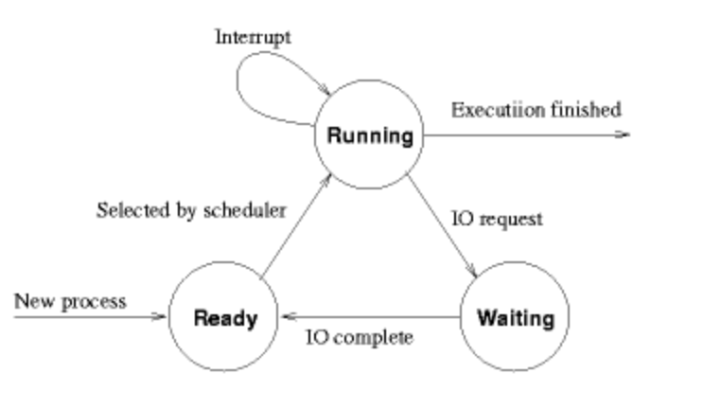
Process State

Slide 127
CPU Scheduling
CPU Scheduler selects from among the processes in memory that are ready to execute and allocates the CPU to one of them.
CPU scheduling decisions may take place when a process:
1. Switches from running to waiting state
2. Switches from running to ready state
3. Switches from waiting to ready
Terminates
Scheduling under 1 and 4 is non-preemptive
All other scheduling is preemptive – implications for data sharing between threads/processes
CPU scheduler optimizes CPU utilization and/or throuput.

Slide 128
CPU Scheduling Algorithms
First-come-First-Serve (FCFS)
Round robin
Shortest-job First (SJF)
Priority-based

Slide 129
OS Responsibilities (2/5): Memory Management
To execute a program all (or part) of the instructions/data must be in memory
Memory management determines what is in memory and when
Optimizing CPU utilization and computer response to users
Memory management activities
Keeping track of which parts of memory are currently being used and by whom
Deciding which processes (or parts thereof) and data to move into and out of memory
Allocating and deallocating memory space as needed

Slide 130
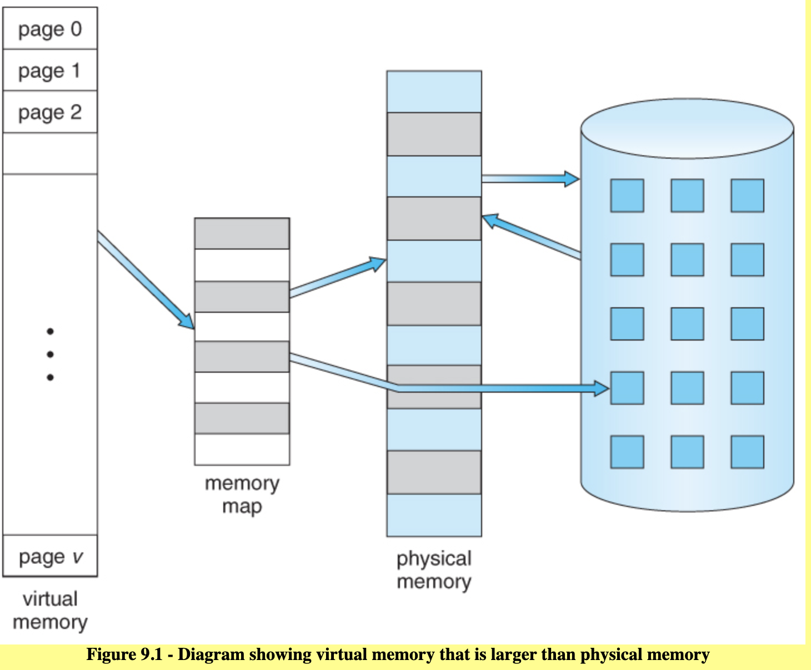
Virtual Memory
Page replacement algorithms:
First-in-first-out (FIFO)
Last-in-first-out (LIFO)
Least-frequently used
Random

Slide 131
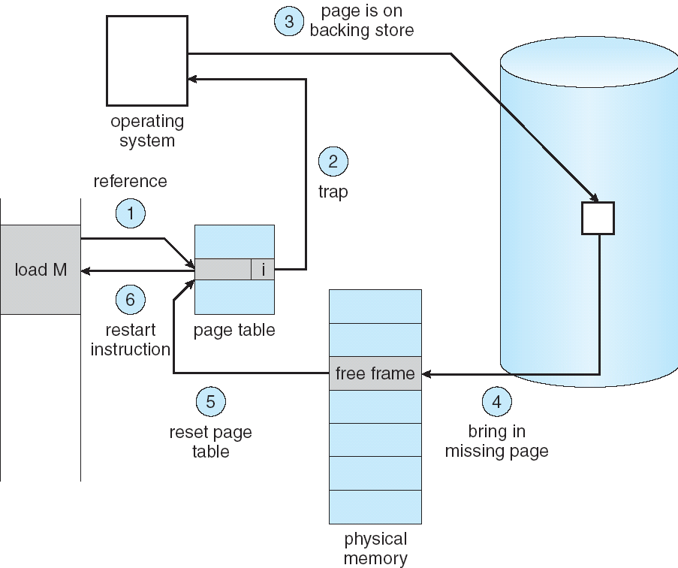
Steps in Handling a Page Fault

Slide 132
OS Responsibilities (3/5): Storage Management
OS provides uniform, logical view of information storage
Abstracts physical properties to logical storage unit - file
Each medium is controlled by device (i.e., disk drive, tape drive)
Varying properties include access speed, capacity, data-transfer rate, access method (sequential or random)
File-System management
Files usually organized into directories
Access control on most systems to determine who can access what
OS activities include
Creating and deleting files and directories
Primitives to manipulate files and directories
Mapping files onto secondary storage
Backup files onto stable (non-volatile) storage media

Slide 133
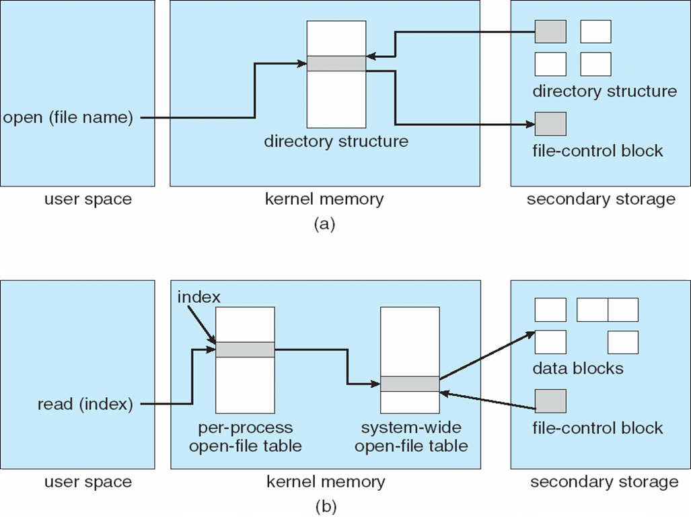
In-Memory File System Structures

Slide 134
Storage Management (continued) Mass-Storage Management
Usually, disks used to store data that does not fit in main memory or data that must be kept for a “long” period of time
Proper management is of central importance
Entire speed of computer operation hinges on disk subsystem and its algorithms
OS activities
Free-space management
Storage allocation
Disk scheduling
Some storage need not be fast
Tertiary storage includes optical storage, magnetic tape
Still must be managed – by OS or applications
Varies between WORM (write-once, read-many-times) and RW (read-write)

Slide 135
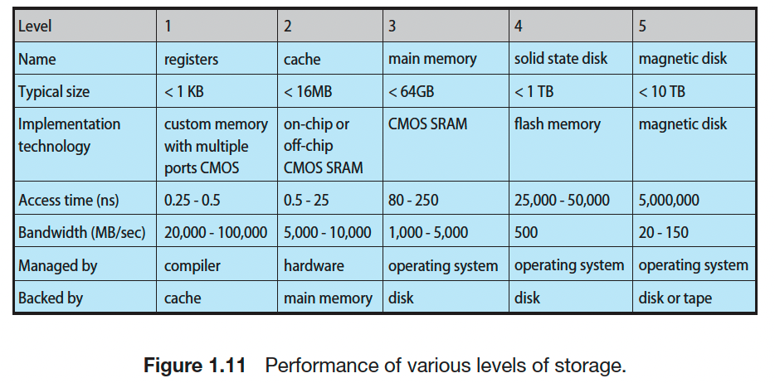

Slide 136
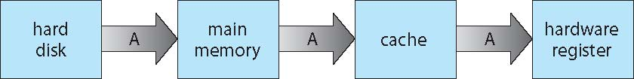
Migration of data “A” from Disk to Register
Multitasking environments must be careful to use most recent value, no matter where it is stored in the storage hierarchy
Multiprocessor environment must provide cache coherency in hardware such that all CPUs have the most recent value in their cache
Distributed environment situation even more complex
Several copies of a datum can exist

Slide 137
OS Responsibilities (4/5): I/O Subsystem
One purpose of OS is to hide peculiarities of hardware devices from the user
I/O subsystem responsible for
Memory management of I/O including buffering (storing data temporarily while it is being transferred), caching (storing parts of data in faster storage for performance), spooling (the overlapping of output of one job with input of other jobs)
General device-driver interface
Drivers for specific hardware devices

Slide 138
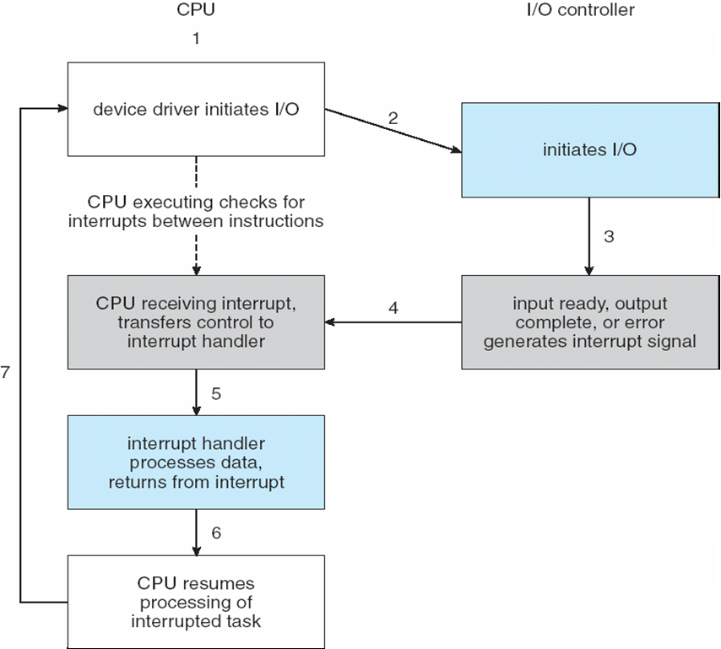
Interrupt-Driven I/O Cycle

Slide 139
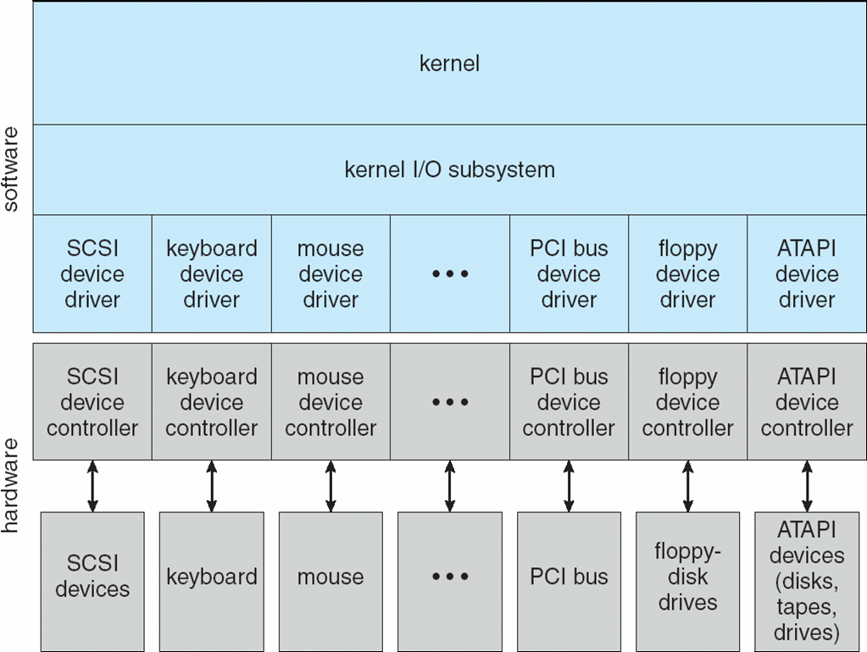
A Kernel I/O Structure

Slide 140
OS Responsibilities (5/5): Protection and Security
Protection – any mechanism for controlling access of processes or users to resources defined by the OS
Security – defense of the system against internal and external attacks
Huge range, including denial-of-service, worms, viruses, identity theft, theft of service
Systems generally first distinguish among users, to determine who can do what
User identities (user IDs, security IDs) include name and associated number, one per user
User ID then associated with all files, processes of that user to determine access control
Group identifier (group ID) allows set of users to be defined and controls managed, then also associated with each process, file
Privilege escalation allows user to change to effective ID with more rights

Slide 141
Chapter 16: Virtual Machines

Slide 142
Chapter 16: Virtual Machines
Overview
History
Benefits and Features
Building Blocks
Types of Virtual Machines and Their Implementations
Virtualization and Operating-System Components
Examples

Slide 143
Chapter Objectives
Explore the history and benefits of virtual machines
Discuss the various virtual machine technologies
Describe the methods used to implement virtualization
Show the most common hardware features that support virtualization and explain how they are used by operating-system modules
Discuss current virtualization research areas

Slide 144
Overview
Fundamental idea – abstract hardware of a single computer into several different execution environments
Similar to layered approach
But layer creates virtual system (virtual machine, or VM) on which operation systems or applications can run
Several components
Host – underlying hardware system
Virtual machine manager (VMM) or hypervisor – creates and runs virtual machines by providing interface that is identical to the host
(Except in the case of paravirtualization)
Guest – process provided with virtual copy of the host
Usually an operating system
Single physical machine can run multiple operating systems concurrently, each in its own virtual machine

Slide 145
System Models
Non-virtual machine
Virtual machine

Slide 146
Implementation of VMMs
Vary greatly, with options including:
Type 0 hypervisors - Hardware-based solutions that provide support for virtual machine creation and management via firmware
IBM LPARs and Oracle LDOMs are examples
Type 1 hypervisors - Operating-system-like software built to provide virtualization
Including VMware ESX, Joyent SmartOS, and Citrix XenServer
Type 1 hypervisors – Also includes general-purpose operating systems that provide standard functions as well as VMM functions
Including Microsoft Windows Server with HyperV and RedHat Linux with KVM
Type 2 hypervisors - Applications that run on standard operating systems but provide VMM features to guest operating systems
Including VMware Workstation and Fusion, Parallels Desktop, and Oracle VirtualBox

Slide 147
Implementation of VMMs (Cont.)
Other variations include:
Paravirtualization - Technique in which the guest operating system is modified to work in cooperation with the VMM to optimize performance
Programming-environment virtualization - VMMs do not virtualize real hardware but instead create an optimized virtual system
Used by Oracle Java and Microsoft .Net
Emulators – Allow applications written for one hardware environment to run on a very different hardware environment, such as a different type of CPU

Slide 148
Implementation of VMMs (Cont.)
Application containment - Not virtualization at all but rather provides virtualization-like features by segregating applications from the operating system, making them more secure, manageable
Including Oracle Solaris Zones, BSD Jails, and IBM AIX WPARs
Much variation due to breadth, depth and importance of virtualization in modern computing

Slide 149
History
First appeared in IBM mainframes in 1972
Allowed multiple users to share a batch-oriented system
Formal definition of virtualization helped move it beyond IBM
A VMM provides an environment for programs that is essentially identical to the original machine
Programs running within that environment show only minor performance decreases
The VMM is in complete control of system resources
In late 1990s Intel CPUs fast enough for researchers to try virtualizing on general purpose PCs
Xen and VMware created technologies, still used today
Virtualization has expanded to many OSes, CPUs, VMMs

Slide 150
Benefits and Features
Security: Host system protected from VMs, VMs protected from each other
i.e., A virus less likely to spread
Sharing is provided though via shared file system volume, network communication
Portability & Management: Freeze, suspend, running VM
Then can move or copy somewhere else and resume
Snapshot of a given state, able to restore back to that state
Some VMMs allow multiple snapshots per VM
Clone by creating copy and running both original and copy
Great for OS research, better system development efficiency
Run multiple, different OSes on a single machine
Consolidation, app dev, …

Slide 151
Benefits and Features (Cont.)
Templating – create an OS + application VM, provide it to customers, use it to create multiple instances of that combination
Live migration – move a running VM from one host to another!
No interruption of user access
Helps to achieve desired QoS and SLA.
All those features taken together -> cloud computing
Using APIs, programs tell cloud infrastructure (servers, networking, storage) to create new guests, VMs, virtual desktops

Slide 152
Building Blocks
Generally difficult to provide an exact duplicate of underlying machine
Especially if only dual-mode operation available on CPU
But getting easier over time as CPU features and support for VMM improves
Most VMMs implement virtual CPU (VCPU) to represent state of CPU per guest as guest believes it to be
When guest context switched onto CPU by VMM, information from VCPU loaded and stored
Several techniques, as described in next slides
Building blocks:
Trap and emulate
Binary translation
Hardware-assisted

Slide 153
Building Block – Trap and Emulate
Dual mode CPU means guest executes in user mode
Kernel runs in kernel mode
Not safe to let guest kernel run in kernel mode too – it may affect other concurrently running machines
So VM needs two modes – virtual user mode and virtual kernel mode
Actions in guest that usually cause switch to kernel mode must cause switch to virtual kernel mode
Both of which run in real user mode

Slide 154
Trap-and-Emulate (Cont.)
How does switch from virtual user mode to virtual kernel mode occur?
Attempting a privileged instruction in user mode causes an error -> trap
VMM gains control, analyzes error, executes operation as attempted by guest
Returns control to guest in user mode
Known as trap-and-emulate
Most virtualization products use this at least in part
User mode code in guest runs at same speed as if not a guest
But kernel mode privilege mode code runs slower due to trap-and-emulate
Especially a problem when multiple guests running, each needing trap-and-emulate
CPUs adding hardware support, multiple CPU modes to improve virtualization performance

Slide 155
Trap-and-Emulate: Virtualization Implementation

Slide 156
Building Block – Binary Translation
Some CPUs don’t have clean separation between privileged and nonprivileged instructions
Earlier Intel x86 CPUs are among them
Earliest Intel CPU designed for a calculator
Backward compatibility means difficult to improve
Consider Intel x86 popf instruction
Loads CPU flags register from contents of the stack
If CPU in privileged mode -> all flags replaced
If CPU in user mode -> only some flags replaced
No trap is generated

Slide 157
Binary Translation (Cont.)
Other similar problem instructions we will call special instructions
Caused trap-and-emulate method considered impossible until 1998
Binary translation solves the problem
Basics are simple, but implementation very complex
If guest VCPU is in user mode, guest can run instructions natively
If guest VCPU in kernel mode (guest believes it is in kernel mode)
VMM examines every instruction guest is about to execute by reading a few instructions ahead of program counter
Non-special-instructions run natively
Special instructions translated into new set of instructions that perform equivalent task (for example changing the flags in the VCPU)

Slide 158
Binary Translation (Cont.)
Implemented by translation of code within VMM
Code reads native instructions dynamically from guest, on demand, generates native binary code that executes in place of original code
Performance of this method would be poor without optimizations
Products like VMware use caching
Translate once, and when guest executes code containing special instruction cached translation used instead of translating again
Testing showed booting Windows XP as guest caused 950,000 translations, at 3 microseconds each, or 3 second (5 %) slowdown over native

Slide 159
Binary Translation: Virtualization Implementation

Slide 160
Nested Page Tables
Memory management another general challenge to VMM implementations
How can VMM keep page-table state for both guests believing they control the page tables and VMM that does control the tables?
Common method (for trap-and-emulate and binary translation) is nested page tables (NPTs)
Each guest maintains page tables to translate virtual to physical addresses
VMM maintains per guest NPTs to represent guest’s page-table state
Just as VCPU stores guest CPU state
When guest on CPU -> VMM makes that guest’s NPTs the active system page tables
Guest tries to change page table -> VMM makes equivalent change to NPTs and its own page tables
Can cause many more TLB misses -> much slower performance
TLB: Translation Lookaside Buffer

Slide 161
Nested Page Tables

Slide 162
Building Blocks – Hardware Assistance
All virtualization needs some HW support
More support -> more feature rich, stable, better performance of guests
Intel added new VT-x instructions in 2005 and AMD the AMD-V instructions in 2006
CPUs with these instructions remove need for binary translation
Generally define more CPU modes – “guest” and “host”
VMM can enable host mode, define characteristics of each guest VM, switch to guest mode and guest(s) on CPU(s)
In guest mode, guest OS thinks it is running natively, sees devices (as defined by VMM for that guest)
Access to virtualized device, privileged instructions cause trap to VMM
CPU maintains VCPU, context switches it as needed
HW support for Nested Page Tables, DMA, interrupts as well over time

Slide 163
Types of Virtual Machines and Implementations
Many variations as well as HW details
Assume VMMs take advantage of HW features
HW features can simplify implementation, improve performance
Whatever the type, a VM has a lifecycle
Created by VMM
Resources assigned to it (number of cores, amount of memory, networking details, storage details)
In type 0 hypervisor, resources usually dedicated
Other types dedicate or share resources, or a mix
When no longer needed, VM can be deleted, freeing resources
Steps simpler, faster than with a physical machine install
Can lead to virtual machine sprawl with lots of VMs, history and state difficult to track

Slide 164
Types of VMMs
Type 0
Type 1
Type 2
Paravirtualization
Programming-environment virtualization
Emulation
Application Containment

Slide 165
Types of VMs – Type 0 Hypervisor
Old idea, under many names by HW manufacturers
“partitions”, “domains”
A HW feature implemented by firmware
OS need to do nothing special, VMM is in firmware
Smaller feature set than other types
Each guest has dedicated HW
I/O a challenge as difficult to have enough devices, controllers to dedicate to each guest
Sometimes VMM implements a control partition running daemons that other guests communicate with for shared I/O
Can provide virtualization-within-virtualization (guest itself can be a VMM with guests)
Other types have difficulty doing this

Slide 166
Type 0 Hypervisor

Slide 167
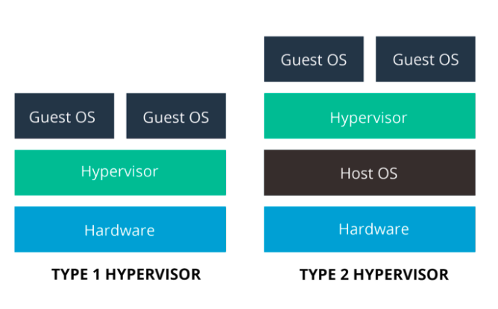
Type 1 & Type 2 Hypervisors

Slide 168
Types of VMs – Type 1 Hypervisor
Commonly found in company datacenters
In a sense becoming “datacenter operating systems”
Datacenter managers control and manage OSes in new, sophisticated ways by controlling the Type 1 hypervisor
Consolidation of multiple OSes and apps onto less HW
Move guests between systems to balance performance
Snapshots and cloning

Slide 169
Types of VMs – Type 1 Hypervisor (Cont.)
Special purpose operating systems that run natively on HW
Rather than providing system call interface, create run and manage guest OSes
Can run on Type 0 hypervisors but not on other Type 1s
Run in kernel mode
Guests generally don’t know they are running in a VM
Implement device drivers for host HW because no other component can
Also provide other traditional OS services like CPU and memory management

Slide 170
Types of VMs – Type 1 Hypervisor (Cont.)
Another variation is a general purpose OS that also provides VMM functionality
RedHat Enterprise Linux with KVM, Windows with Hyper-V, Oracle Solaris
Perform normal duties as well as VMM duties
Typically less feature rich than dedicated Type 1 hypervisors
In many ways, treat guests OSes as just another process
Albeit with special handling when guest tries to execute special instructions

Slide 171
Types of VMs – Type 2 Hypervisor
Less interesting from an OS perspective
Very little OS involvement in virtualization
VMM is simply another process, run and managed by host
Even the host doesn’t know they are a VMM running guests
Tend to have poorer overall performance because can’t take advantage of some HW features
But also a benefit because require no changes to host OS
Student could have Type 2 hypervisor on native host, run multiple guests, all on standard host OS such as Windows, Linux, MacOS

Slide 172
Types of VMs – Paravirtualization
Does not fit the definition of virtualization – VMM not presenting an exact duplication of underlying hardware
But still useful!
VMM provides services that guest must be modified to use
Leads to increased performance
Less needed as hardware support for VMs grows
Xen, leader in paravirtualized space, adds several techniques
For example, clean and simple device abstractions
Efficient I/O
Good communication between guest and VMM about device I/O
Each device has circular buffer shared by guest and VMM via shared memory

Slide 173
Xen I/O via Shared Circular Buffer

Slide 174
Types of VMs – Paravirtualization (Cont.)
Xen, leader in paravirtualized space, adds several techniques (Cont.)
Memory management does not include nested page tables
Each guest has own read-only tables
Guest uses hypercall (call to hypervisor) when page-table changes needed
Paravirtualization allowed virtualization of older x86 CPUs (and others) without binary translation
Guest had to be modified to use run on paravirtualized VMM
But on modern CPUs Xen no longer requires guest modification -> no longer paravirtualization

Slide 175
Types of VMs: Programming Environment Virtualization
Also not-really-virtualization but using same techniques, providing similar features
Programming language is designed to run within custom-built virtualized environment
For example Oracle Java has many features that depend on running in Java Virtual Machine (JVM)
In this case virtualization is defined as providing APIs that define a set of features made available to a language and programs written in that language to provide an improved execution environment
JVM compiled to run on many systems (including some smart phones even)
Programs written in Java run in the JVM no matter the underlying system
Similar to interpreted languages

Slide 176
Types of VMs – Emulation
Another (older) way for running one operating system on a different operating system
Virtualization requires underlying CPU to be same as guest was compiled for
Emulation allows guest to run on different CPU
Necessary to translate all guest instructions from guest CPU to native CPU
Emulation, not virtualization
Useful when host system has one architecture, guest compiled for other architecture
Company replacing outdated servers with new servers containing different CPU architecture, but still want to run old applications
Performance challenge – order of magnitude slower than native code
New machines faster than older machines so can reduce slowdown
Very popular – especially in gaming where old consoles emulated on new

Slide 177
Types of VMs: Application Containment
Some goals of virtualization are segregation of apps, performance and resource management, easy start, stop, move, and management of them
Can do those things without full-fledged virtualization
If applications compiled for the host operating system, don’t need full virtualization to meet these goals
Oracle containers / zones for example create virtual layer between OS and apps
Only one kernel running – host OS
OS and devices are virtualized, providing resources within zone with impression that they are only processes on system
Each zone has its own applications; networking stack, addresses, and ports; user accounts, etc
CPU and memory resources divided between zones
Zone can have its own scheduler to use those resources

Slide 178
Solaris 10 with Two Zones

Slide 179
Virtualization and Operating-System Components
Now look at operating system aspects of virtualization
CPU scheduling, memory management, I/O, storage, and unique VM migration feature
How do VMMs schedule CPU use when guests believe they have dedicated CPUs?
How can memory management work when many guests require large amounts of memory?

Slide 180
OS Component – CPU Scheduling
Even single-CPU systems act like multiprocessor ones when virtualized
One or more virtual CPUs per guest
Generally VMM has one or more physical CPUs and number of threads to run on them
Guests configured with certain number of VCPUs
Can be adjusted throughout life of VM
When enough CPUs for all guests -> VMM can allocate dedicated CPUs, each guest much like native operating system managing its CPUs
Usually not enough CPUs -> CPU overcommitment
VMM can use standard scheduling algorithms to put threads on CPUs
Some add fairness aspect

Slide 181
OS Component: CPU Scheduling (Cont.)
Cycle stealing by VMM and oversubscription of CPUs means guests don’t get CPU cycles they expect
Consider timesharing scheduler in a guest trying to schedule 100ms time slices -> each may take 100ms, 1 second, or longer
Poor response times for users of guest
Time-of-day clocks incorrect
Some VMMs provide application to run in each guest to fix time-of-day and provide other integration features

Slide 182
OS Component – Memory Management
Also suffers from oversubscription -> requires extra management efficiency from VMM
For example, VMware ESX guests have a configured amount of physical memory, then ESX uses 3 methods of memory management
Double-paging, in which the guest page table indicates a page is in a physical frame but the VMM moves some of those pages to backing store
Install a pseudo-device driver in each guest (it looks like a device driver to the guest kernel but really just adds kernel-mode code to the guest)
Balloon memory manager communicates with VMM and is told to allocate or de-allocate memory to decrease or increase physical memory use of guest, causing guest OS to free or have more memory available
De-duplication by VMM determining if same page loaded more than once, memory mapping the same page into multiple guests

Slide 183
OS Component – I/O
Easier for VMMs to integrate with guests because I/O has lots of variation
Already somewhat segregated / flexible via device drivers
VMM can provide new devices and device drivers
But overall I/O is complicated for VMMs
Many short paths for I/O in standard OSes for improved performance
Less hypervisor needs to do for I/O for guests, the better
Possibilities include direct device access, DMA pass-through, direct interrupt delivery
Again, HW support needed for these
Networking also complex as VMM and guests all need network access
VMM can bridge guest to network (allowing direct access)
And / or provide network address translation (NAT)
NAT address local to machine on which guest is running, VMM provides address translation to guest to hide its address

Slide 184
OS Component – Storage Management
Both boot disk and general data access need be provided by VMM
Need to support potentially dozens of guests per VMM (so standard disk partitioning not sufficient)
Type 1 – storage guest root disks and config information within file system provided by VMM as a disk image
Type 2 – store as files in file system provided by host OS
Duplicate file -> create new guest
Move file to another system -> move guest
Physical-to-virtual (P-to-V) convert native disk blocks into VMM format
Virtual-to-physical (V-to-P) convert from virtual format to native or disk format
VMM also needs to provide access to network attached storage (just networking) and other disk images, disk partitions, disks, etc.

Slide 185
OS Component – Live Migration
Taking advantage of VMM features leads to new functionality not found on general operating systems such as live migration
Running guest can be moved between systems, without interrupting user access to the guest or its apps
Very useful for resource management, maintenance downtime windows, etc.
The source VMM establishes a connection with the target VMM
The target creates a new guest by creating a new VCPU, etc.
The source sends all read-only guest memory pages to the target
The source sends all read-write pages to the target, marking them as clean
The source repeats step 4, as during that step some pages were probably modified by the guest and are now dirty
When cycle of steps 4 and 5 becomes very short, source VMM freezes guest, sends VCPU’s final state, sends other state details, sends final dirty pages, and tells target to start running the guest
Once target acknowledges that guest running, source terminates guest

Slide 186
Live Migration of Guest Between Servers

Slide 187
Examples – VMware Workstation
VMware Workstation runs on x86, provides VMM for guests
Runs as application on other native, installed host operating system -> Type 2
Lots of guests possible, including Windows, Linux, etc. all runnable concurrently (as resources allow)
Virtualization layer abstracts underlying HW, providing guest with is own virtual CPUs, memory, disk drives, network interfaces, etc.
Physical disks can be provided to guests, or virtual physical disks (just files within host file system)

Slide 188
VMware Workstation Architecture

Slide 189
Examples – Java Virtual Machine
Example of programming-environment virtualization
Very popular language / application environment invented by Sun Microsystems in 1995
Write once, run anywhere
Includes language specification (Java), API library, Java virtual machine (JVM)
Java objects specified by class construct, Java program is one or more objects
Each Java object compiled into architecture-neutral bytecode output (.class) which JVM class loader loads
JVM compiled per architecture, reads bytecode and executes
Includes garbage collection to reclaim memory no longer in use
Made faster by just-in-time (JIT) compiler that turns bytecodes into native code and caches them

Slide 190
The Java Virtual Machine

Slide 191
End of Chapter 18

